Slide 1
Writing Parallel Program-3

Slide 2
Recap
Shared and Private
Schedule: static, dynamic
nowait

Slide 3
Recap: Shared and Private
int n; int a; int b;
:
#pragma omp parallel for shared(n, a) private(b)
for (int i = 0; i < n; i++) {
int t = b;
// b = a + i;
}

Slide 4
Recap: Schedule
// number of threads = 10
#pragma omp parallel for shared(a,b,c) private(i) schedule(static)
parallel for(i=0;i<N;i++)
c[i] = a[i] + b[i];
Distribute the chunk of iterations to threads
thread 1 : iteration 0…(N/10)-1
thread 2: iteration (N/10)…2*(N/10)-1
:
thread 10: iteration 9*(N/10)…N-1

Slide 5
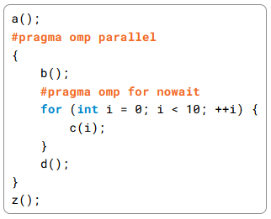
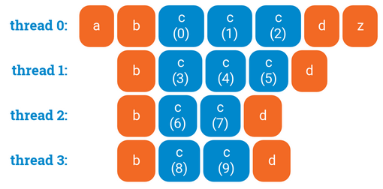
Waiting in `parallel for’
`nowait’ removes the synchronization
Ref: https://ppc.cs.aalto.fi/ch3/nowait/

Slide 6
Q & A Discussion
piazza
Scope of private variable
Nested parallel constructs

Slide 7
Distribution of Iterations
// number of threads = 10
#pragma omp parallel for shared(a,b,c) private(i) schedule(static)
parallel for(i=0;i<N;i++)
c[i] = a[i] + b[i];
Distribute the chunk of iterations to threads
thread 1 : for(int i1=0;i1<N/10;i1++) c[i1] = a[i1] + b[i1];
thread 2: for(int i2=N/10; ;i2<(2*N)/10; i2++) c[i2] = a[i2] + b[i2];
:
thread 10: for(int i10=(9*N)/10; i10<N; i10++) c[i10] = a[i10] + b[i10];

Slide 8
Distribution of Iterations
// number of threads = 10
#pragma omp parallel for shared(a,b,c) private(i) schedule(static, N/10)
for(i=0;i<N;i++)
c[i] = a[i] + b[i];
What if N < 10 ?

Slide 9
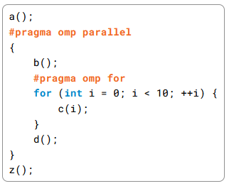
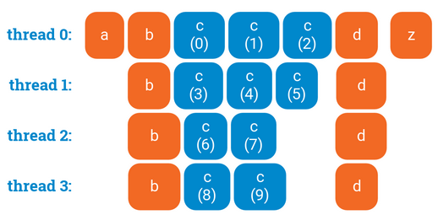
Nested Parallelism
Can be controlled by omp_set_nested()
omp_set_nested(0) // FALSE: no nested parallelization
omp_set_nested(1) // TRUE: nested parallelization

Slide 10
Synchronization
Orders the completion of code executed by different threads
Several constructs
- barrier
- critical
:

Slide 11
Barrier
A program point where all active threads will stop until all threads have arrived at that point.
#pragma omp parallel {
int i = omp_get_thread_num();
a[i] = i;
#pragma omp barrier
b[i] = i;
}
a
b

Slide 12
Implicit Barrier in `parallel for’
Threads synchronize at the end of a parallel for loop.
Ref: https://ppc.cs.aalto.fi/ch3/nowait/

Slide 13
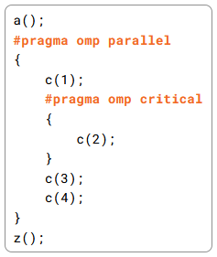
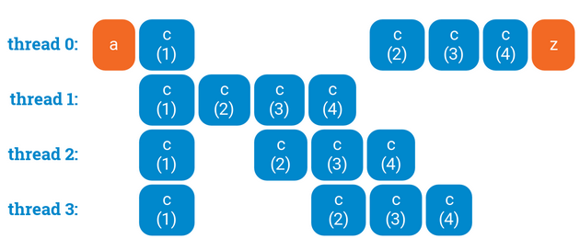
Critical Section
Only one thread execute a critical section at a time.
Provides mutual exclusion.
Ref: https://ppc.cs.aalto.fi/ch3/

Slide 14
Data Race
Multiple parallel threads access one shared memory location where
at least one of these accesses is a write.
The read or written value is undefined
Example
#pragma omp parallel for
for(int i=0;i<N;i++) {
sum = sum + f(a[i]);
}
Can we fix it?

Slide 15
Data Race
Multiple parallel threads access one shared memory location where
at least one of these accesses is a write.
The read or written value is undefined
Example
#pragma omp parallel for
for(int i=0;i<N;i++) {
#pragma omp critical
{
sum = sum + f(a[i]);
}
}

Slide 16
Caveats
No automatic parallelization; parallelization is programmer specified
Programmer is responsible to ensure correctness of the parallelized program
`parallel for’ does not work with other loop constructs e.g. while.
When should we NOT parallelize a loop?

Slide 17
When should we NOT parallelize a loop?
Answer: If there are data dependencies across iterations
Example:
for(int i=0;i<N;i++)
sum = sum + a[i];
The definition of `sum’ in iteration i is used in iteration (i+1)

Slide 18
References
Chapter 5
An Introduction to Parallel Programming
by Peter Pacheco.
Chapter 17
Parallel programming in C with MPI and OpenMP
by Michael J. Quinn.
OpenMP Specification.
https://www.openmp.org/spec-html/5.0/openmp.html

