Slide 1
Visual Cryptography
Moni Naor
Adi Shamir
Presented By:
Salik Jamal Warsi
Siddharth Bora

Slide 2
Cryptography
A very hot topic today which involves the following steps :
  Plain Text
  Encryption
  Cipher Text
  Channel
  Decryption
  Plain Text

Slide 3
Visual Cryptography
Visual cryptography is a cryptographic technique which allows visual information (pictures, text, etc.) to be encrypted in such a way that decryption becomes a mechanical operation that does not require a computer.
Such a technique thus would be lucrative for defense and security.

Slide 4
Visual Cryptography
Plaintext is as an image.
Encryption involves creating “shares” of the image which in a sense will be a piece of the image.
Give the shares to the respective holders.
Decryption – involving bringing together the an appropriate combination and the human visual system.

Slide 5
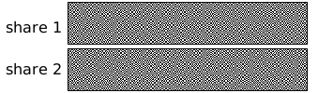
AN EXAMPLE
Concept of Secrecy

Slide 6
AN Example
So basically it involves dividing the image into two parts:
  Key : a transparency
  Cipher : a printed page
Separately, they are random noise
Combination reveals an image

Slide 7
Secret Sharing - ViSUAL
Refers to a method of sharing a secret to a group of participants.
Dealer provides a transparency to each one of the n users.
Any k of them can see the secret by stacking their transparencies, but any k-1 of them gain no information about it.
Main result of the paper include practical implementations for small values of k and n.

Slide 8
Background
The image will be represented as black and white pixels
Grey Level: The brightness value assigned to a pixel; values range from black, through gray, to white.
Hamming Weight (H(V)): The number of non-zero symbols in a symbol sequence.
Concept of qualified and forbidden set of participants

Slide 9


Encoding the pixels
Pixel
Share 1
Share 2
Overlaid

Slide 10
The MODEL
Each original pixel appears in n modified versions (called shares), one for each transparency.
Each share is a collection of m black and white sub-pixels.
The resulting structure can be described by an n x m Boolean matrix S = [s_{ij}] where s_{ij}=1 iff the jth sub-pixel of the ith transparency is black.

Slide 11
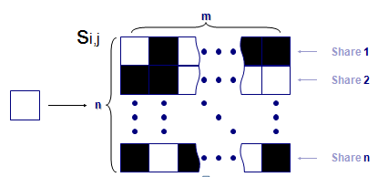
The MODEL
Pixel Division
(per share)
Pixel
(in the group n)
m
Pixel
Subpixels

Slide 12


THE MODEL
The grey level of the combined share is interpreted by the visual system:
  as black if
  as white if .
is some fixed threshold and
is the relative difference.
H(V) is the hamming weight of the “OR” combined share vector of rows i₁,…i_{n} in S vector.

Slide 13
Conditions
1. For any S in S0 , the “or” V of any k of the n rows satisfies H(V ) < d-α.m
2. For any S in S1 , the “or” V of any k of the n rows satisfies H(V ) >= d.
n-Total Participant
k-Qualified Participant

Slide 14
Conditions
3. For any subset {i1;i2; : : ;iq} of {1;2; : : ;n} with q < k, the two collections of q x m matrices Dt for t ε {0,1} obtained by restricting each n x m matrix in Ct (where t = 0;1) to rows i1;i2; : : ;iq are indistinguishable in the sense that they contain the same matrices with the same frequencies.
Condition 3 implies that by inspecting fewer than k shares, even an infinitely powerful cryptanalyst cannot gain any advantage in deciding whether the shared pixel was white or
black.

Slide 15
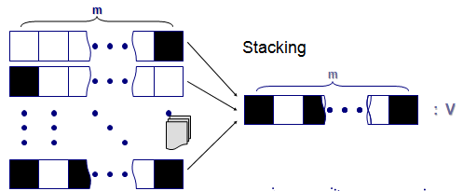
Stacking AND contrast
Concept of Contrast

Slide 16
Properties of sharing matrices
For Contrast: sum of the sum of rows for shares in a decrypting group should be bigger for darker pixels.
For Secrecy: sums of rows in any non-decrypting group should have same probability distribution for the number of 1’s in s₀ and in S₁.

Slide 17
2 out of 2 scheme (2 sub-pixels)
Black and white image: each pixel divided in 2 sub-pixels
Choose the next pixel; if white, then randomly choose one of the two rows for white.
If black, then randomly choose between one of the two rows for black.
Also we are dealing with pixels sequentially; in groups these pixels could give us a better result.

Slide 18
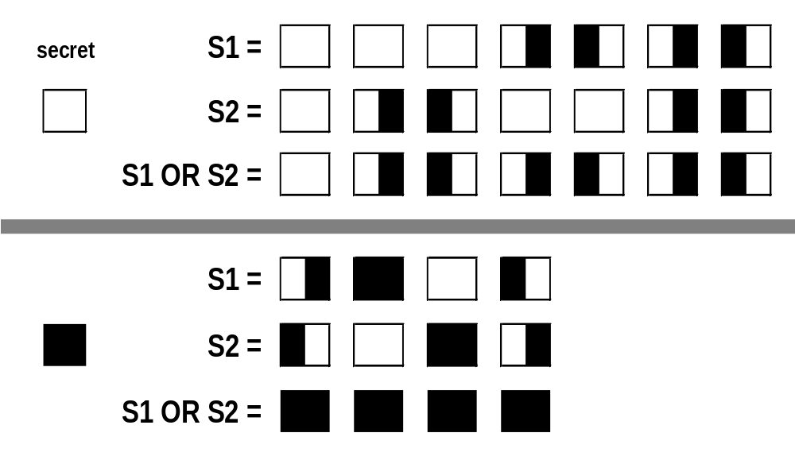
2 out of 2 scheme (2 sub-pixels)

Slide 19
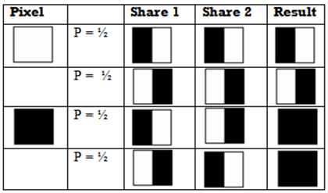

2 out of 2 scheme (2 sub-pixels)

Slide 20
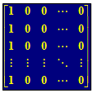
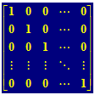
General 2 out of n scheme
We take m=n
White pixel - a random column-permutation of:
Black pixel - a random column-permutation of:

Slide 21
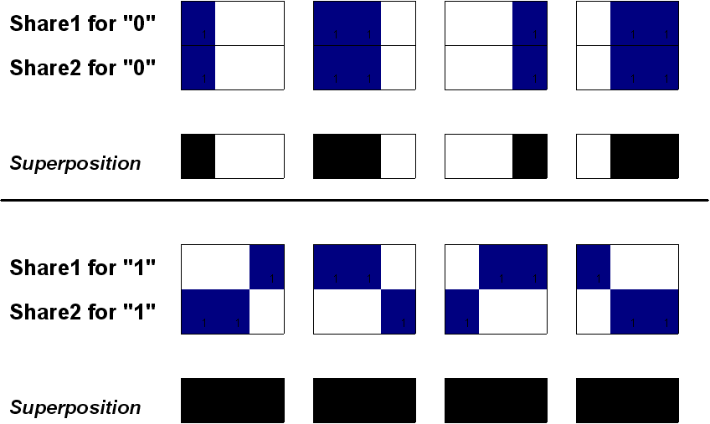

2 out of 2 scheme (3 sub-pixels)
Each matrix selected with equal probability (0.25)
Sum of sum of rows is 1 or 2 in S₀, while it is 3 in S₁
Each share has one or two dark subpixels with equal probabilities (0.5) in both sets.

Slide 22
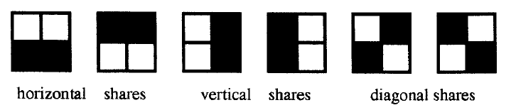
2 out of 2 Scheme (4 subpixels)
The 2 subpixel scheme disrupts the aspect ratio of the image.
A more desirable scheme would involve division into a square of subpixel (size=4)

Slide 23
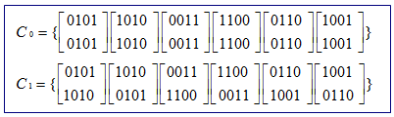
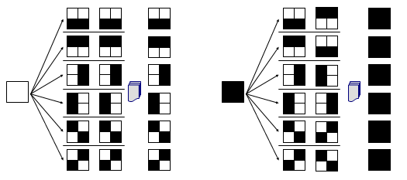
2 out of 2 Scheme (4 subpixels)

Slide 24
General Results on Asymptotics
There is a (k,k) scheme with m=2^{k-1}, α=2^{-k+1} and r=(2^{k-1}!).
  We can construct a (5,5) sharing, with 16 subpixels per secret pixel and, using the permutations of 16 sharing matrices.
In any (k,k) scheme, m≥2^{k-1} and α≤2^{1-k}.
For any n and k, there is a (k,n) Visual Cryptography scheme with m=log n 2^{O(klog k)}, α=2^{Ώ(k)}.

Slide 25
Advantages of Visual Cryptography
Encryption doesn’t required any NP-Hard problem dependency
Decryption algorithm not required (Use a human Visual System). So a person unknown to cryptography can decrypt the message.
We can send cipher text through FAX or E-MAIL
Infinite Computation Power can’t predict the message.

Slide 26
Thank You !

