Slide 1
I Forgot Your Password:
Randomness Attacks Against PHP Applications
George Argyros Aggelos Kiayias

Slide 2
Attacking Pseudo Random Number Generators in PHP
To determine the current state of a random number genrator.
Time attacks
Seed attacks
State recovery attacks

Slide 3
Random functions of the PHP core
php_combined_lcg()/lcg_value(): Two LCG's
uniqid(prefix, extra_entropy): microseconds in hex, php_combined_lcg()
microtime(),time(): seconds and microseconds
mt_srand(seed)/mt_rand(min, max): Mersenne Twister generator.
srand(seed)/rand(min, max) is the interface function to the system's rand() provided by either libc or LCG
openssl_random_pseudo_bytes(length, strong)

Slide 4
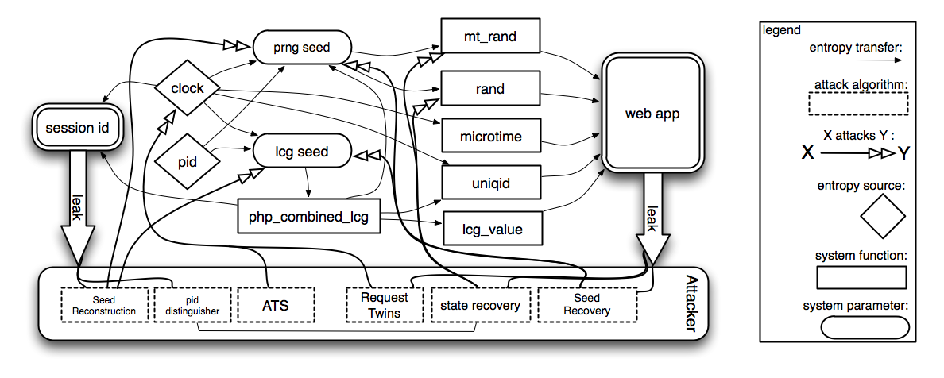
Attack vectors
Different randomization functions in PHP

Slide 5
Targets / Why?
Randomly generated passwords, eg. password reset functions.

Slide 6
Time
The entropy of time measurements
<?php
echo time();
echo microtime();
?>
time() is given by HTTP headers
what about microtime() then?
10⁶ ≈ 2²⁰ possible values

Slide 7
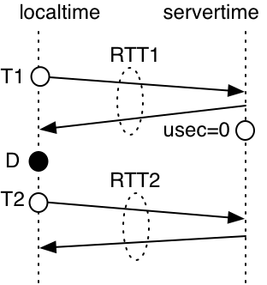
Time
Adversarial Time Synchronization (ATS)
Assume the password reset token is just microtime()
Works just by looking at the
time returned in the HTTP
header

Slide 8
Time
Request Twins
Assume the password reset token is just microtime()
Requires a microtime() output from the server
Request two password resets at the same time:
one for the account under attack
one for your own account

Slide 9
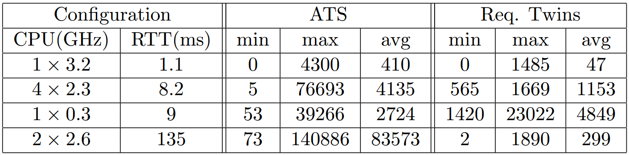
Time
Results

Slide 10
Seed
Seed attacks
But what if the password reset token isn't just the microtime()?

Slide 11
Seed
Leaks
To employ seed attacks we need some kind of leak.
Session identifiers... from fresh processes

Slide 12
Seed
Apache's modes of operation
mod_php (default)
spawns a batch of new processes if too many processes are already occupied.
CGI
a new process for every request
FastCGI
(something like mod_php)

Slide 13
Seed
Recover the php_combined_lcg() seed
The Session ID is a MD5-hash of
Client IP address (32 bits)
Time: Unix epoch and microseconds (32+20 bits)
A value from php_combined_lcg() (64 bits)
But since the php_combined_lcg() seed is also dependent on time, we only get a total of about
40 bits of entropy.
Further apply ATS:
29 bits

Slide 14
Seed
Recover rand() and mt_rand() seed
What about rand() and mt_rand() then?
seed = (epoch × pid)⊕(10⁶ × php_combined_lcg())
epoch
pid
php_combined_lcg()
Notes:
×

Slide 15
State recovery
-"When the seed is good"
The attacks described before have relied on the use of a weak seed.
Suhosin avoids weak seeds by using /dev/urandom
How do we attack a system that has a good seed?

Slide 16
State recovery
-"When the seed is good"
Identify state of PRNG by using multiple leaks.
Problems:
Usually small range of random numbers needed in web applications.
Collecting the leaks requires multiple connections to the site. (mt requires ~650 leaks)

Slide 17
State recovery
-"When the seed is good"
Usually small range of random numbers needed in web applications.
For example when selecting items from an array
Gives information about the original random number generator

Slide 18
State recovery
-"When the seed is good"
Collecting the leaks requires multiple connections to the site.
Multiple processes - We have to distinguish which one we are connected to.
Obtain by cracking the session identifier. MD5(client_ip || time_of_day() || php_combined_lcg())

Slide 19
State recovery
-"When the seed is good"
MD5(client_ip || time_of_day() || php_combined_lcg()) - pid & clock

Slide 20
What to implement
Reliable Adverserial Time Synchornization
Try to apply described methods on real-world php applications

