Slide 1
Protecting Browsers from Cross-Origin CSS Attacks
Lin-Shung Huang, Zack Weinberg
Carnegie Mellon University
Chris Evans
Google
Collin Jackson
Carnegie Mellon University
17th ACM CCS (October, 2010)
Hitesh Kumar
Abhinav Choudhary

Slide 2
Outline
Introduction
Threat Model
Cross-Origin CSS Attacks
Example Attacks
Defenses
Experiment

Slide 3
Introduction
Web-hosted applications have supplanted traditional desktop applications for almost everything that requires network communication.

Slide 4
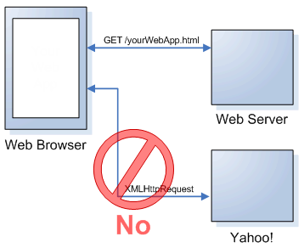
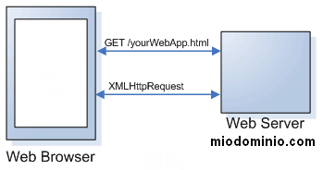
Same-Origin Policy
The same-origin policy is the basic principle used to secure Web applications from each other.

Slide 5
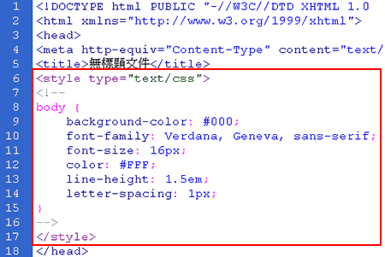
A Web Page Contains…
Content
  HTML
Behavior
  JavaScript
Appearance
  Cascading Style Sheet

Slide 6
Error-Tolerant Parsing
To allow future extensibility, the CSS specification mandates error-tolerant parsing.
This leads to a security hole.
  GreyMagic Security Advisory GM#004-IE (2002)
  To date, all published attacks of this type have required JavaScript, and most have been specific to Internet Explorer.

Slide 7
Threat Model
Attacker Abilities
  Sending and receiving arbitrary network traffic from its own servers.
Target Behavior
  Attacker’s Inject strings must pass server-side cross-site scripting (XSS) filters such as HTML Purifier.
Victim Behavior
  The web attacker can entice the victim into visiting its site.

Slide 8
Cross-Origin CSS Attacks
Cross-origin CSS attacks are possible because of existing browser behaviors, reasonable taken in isolation, but with unexpected interactions.

Slide 9
Browser Behavior
Session Authentication
  Once a user has logged into a web application, their browser will transmit a credential with every HTTP request to that server.

Slide 10
Browser Behavior
Cross-Origin Content Inclusion
  Requests for cross-origin resources transmit any credentials associated with the site that hosts the resource, not credentials associated with the site whose page made the reference.

Slide 11
Browser Behavior
Error-Tolerant Style Sheet Parsing
  When browsers encounter syntax errors in CSS, they discard the current syntactic construct, skip ahead until what appears to be the beginning of the next one.
CSS parsing mode
  Quirks mode
  Strict/standards mode
    <!DOCTYPE html PUBLIC "-//W3C//DTD XHTML 1.0 Transitional//EN" "http://www.w3.org/TR/xhtml1/DTD/xhtml1-transitional.dtd">

Slide 12
Browser Behavior
Principles of error-tolerant style sheet parsing
  Even while skipping, parentheses, square brackets, and curly braces must be properly balanced and nested.
  The next syntactic construct might begin after the next semicolon, after going up one brace level, or after the next brace-enclosed block.
  The end of a style sheet closes all open constructs without error.

Slide 13
Attack Steps
In a cross-origin CSS attack, the attacker injects strings into the target document that bracket the data to be stolen.

Slide 14
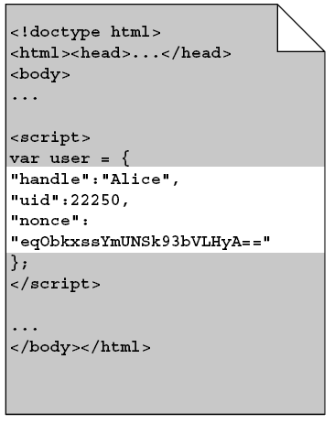
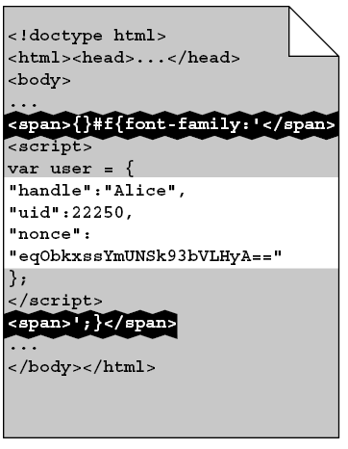
CSS String Injection

Slide 15
Cross-Origin CSS Import
When the victim user visits attacker.com
<LINK REL="stylesheet" HREF="http://target.com">
or
<STYLE>@import url(http://target.com);</STYLE>

Slide 16
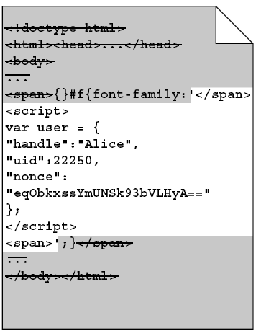
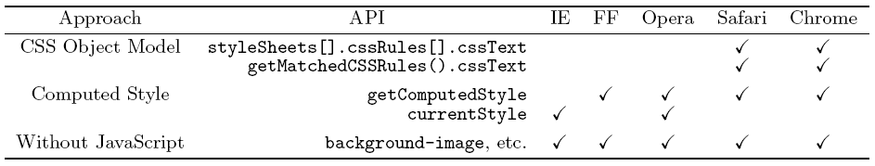
Confidential Data Extraction

Slide 17
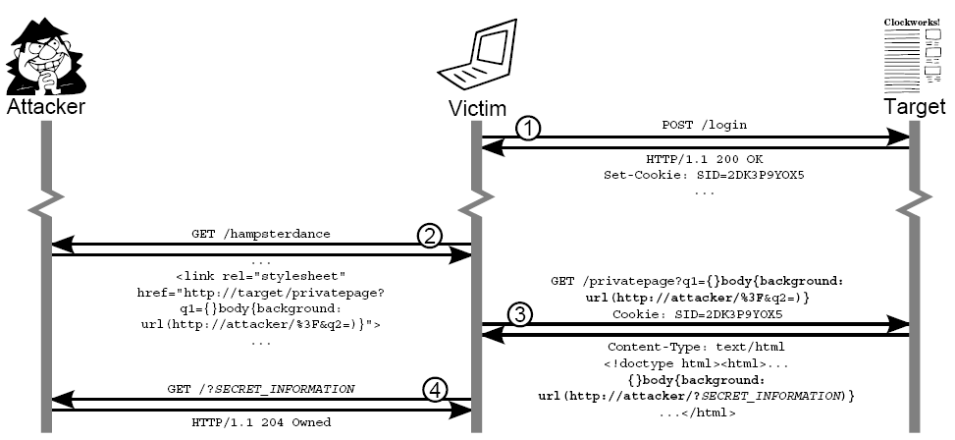

Slide 18
Attack Limitations
Insufficient Injection points
  The attacker must inject two strings into the document containing the secret.
Quotes
  If the secret contains both types of quotes, or the attacker cannot predict which type of quotes it will contain, the attack may fail.

Slide 19
Attack Limitations
Line Breaks
  Internet Explorer permits unescaped line breaks in CSS string constants and url()s.
Character Escapes
Forcing UTF-7
  <LINK REL="stylesheet“ REF=“http://target.com” CHARSET="utf-7">
  {}#f{font-family:+ACI-

Slide 20
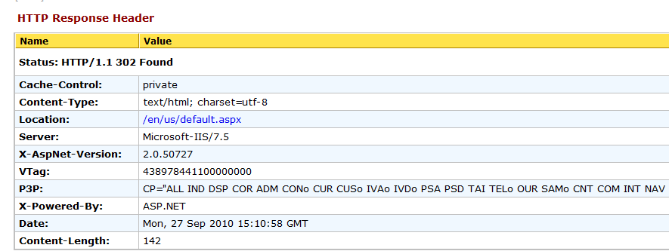
Attack Limitations
Forcing UTF-7
  <LINK REL="stylesheet“ REF=“http://target.com” CHARSET="utf-7">
  {}#f{font-family:+ACI-

Slide 21
Example Attacks
The Internet Movie Database (IMDb)
  allows registered users to rate films, make posts on message boards, and send private messages to each other.

Slide 22
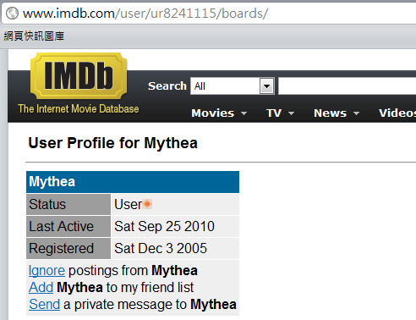
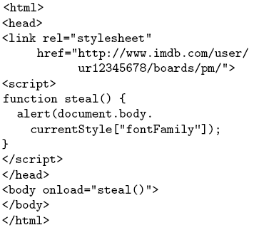
IMDb Example

Slide 23
Yahoo! Mail Example
Send an email to the victim with the subject line:
  ');}
Wait for some time while the victim receives other messages.
Send another email to the victim with the subject line:
  {}body{background-image:url(‘
  Induce the victim to visit attacker.com while signed
  into Yahoo! Mail. The attacking page is as follows

Slide 24
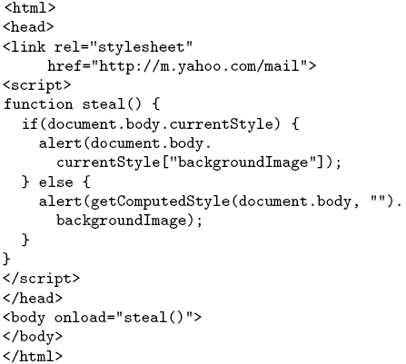
Yahoo! Mail Example

Slide 25
Defenses
Content Type Enforcement Proposal
  HTTP header
    Content-Type: text/css
    Content-Type: text/html
  Strict Enforcement
    Strict enforcement refuses to load any style sheet crossorigin, unless it is properly labeled text/css.
    content type misconfigurations are common

Slide 26
Defenses
  Minimal Enforcement
    Block if:
      cross-origin
      invalid content type
      syntactically malformed

Slide 27
Experiment
crawled the top 100,000 web sites ranked by Alexa and identified all of the style sheet resources used by their front pages.

Slide 28
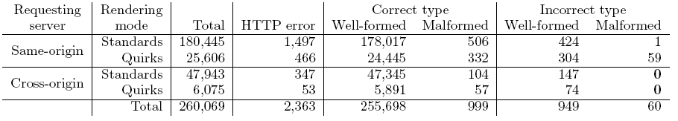
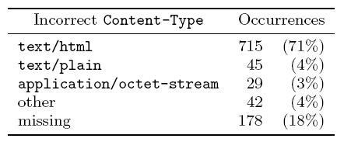
Result
Strict Enforcement
→62 sites ≈ 0.06%

Slide 29
Result
Within the Alexa top 100,000 web sites, we observed a total of 1,009 CSS resources labeled with an incorrect content type (excluding responses with HTTP errors). Of these, 572 are associated with sites being rendered in standards mode, and are therefore already being ignored.
Of the remaining 437 style sheets, 74 are loaded cross-origin; these are the sheets that would be rejected by the strict defense, breaking 62 (0.06%) of the Alexa sites. This is enough to make browser vendors reluctant to deploy strict enforcement.
The minimal defense, which accepts cross-origin, mislabeled sheets unless they are also malformed, would not break any of the top 100,000 sites.

Slide 30
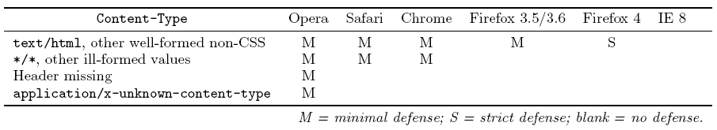
Adoption

Slide 31
Other Client-Side Approaches
Block Cookies
  Some browsers have the option to block only “third-party” cookies, which prevents cookies from being set by a cross-origin load.
  But not read…

Slide 32
Other Client-Side Approaches
Block JavaScript Style APIs
  Many browsers already prevent JavaScript from reading parsed style rules when those rules were loaded cross-origin.

Slide 33
Server-Side Mitigation
Newlines
  Internet Explorer
HTML Encoding
Avoid Ambient Authentication
  However, if a URL with a credential becomes visible to the victim user (e.g. via the location bar), they might be tricked into revealing it.

Slide 34
Thank You

