Slide 1
Privacy Preserving Social Plug-ins
Georgios Kontaxis, Michalis Polychronakis
Angelos D. Keromytis, Evangelos P. Markatos
Siddhant Ujjain (2009cs10219)
Deepak Sharma (2009cs10185)

Slide 2
Introduction
Privacy Issues related to social plug-ins on websites
Even if one doesn’t interact with social plug-ins
Novel design for privacy-preserving social plug-ins without sacrifices in functionality

Slide 3
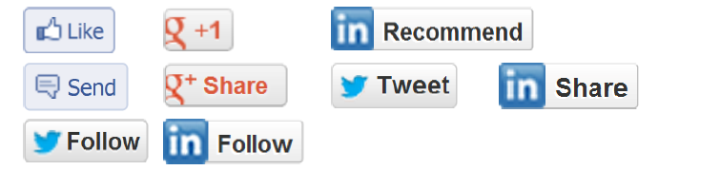
What are social plug-ins?
Provided by online social networking services (SNS)
Included in third-party Web sites
Enable users to interact with the page content through their social identity via a series of actions
Offers personalized information based on social data

Slide 4
How many of them?
Facebook has 955 million users
33% of the Top 10K Web sites have integrated the Like button
(at least 2 million in total)
Google+ has 425 million users
22% of Top 10K sites have integrated the +1 button
(at least 1 million in total)

Slide 5
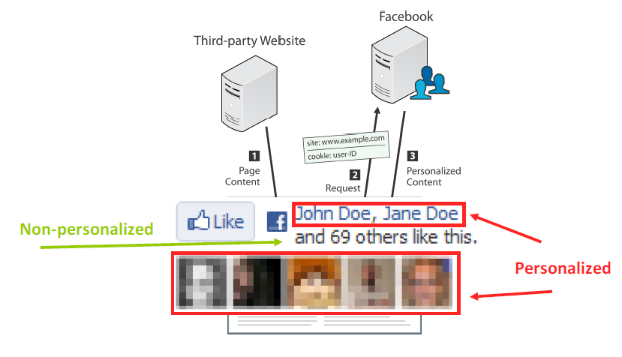
How do Social Plug-ins Work?

Slide 6
Privacy Risks
Social networking services know the user’s real name
Don’t have to interact with a plug-in
Cannot know beforehand whether a page carries plug-ins

Slide 7
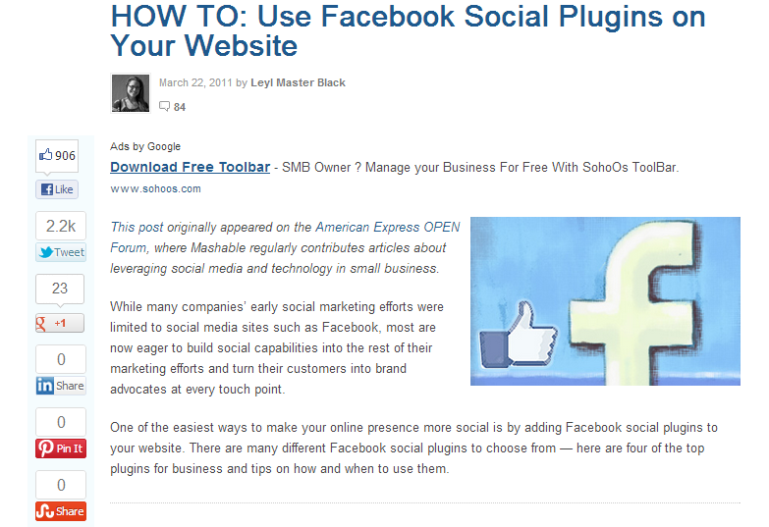
Who knows I visited Mashable.com?

Slide 8



Preventing Privacy Leaks
Logging Out of the Social Networking Service?
  Today at least 2 cookies persist
  Never logged in Facebook
  Logged in, then logged out
  While logged in

Slide 9
Preventing Privacy Leaks
Disabling Third-party Cookies?
  Social plug-ins will render as if the user is not a member of the social networking service
  However, doesn’t always protect from third-party tracking
  In Chrome it’s trivial for a third party to position itself as a first party( popup window – native blocker won’t help)

Slide 10
Preventing Privacy Leaks
Enabling the “Do Not Track HTTP” Header?
  Policy technique, no technical enforcement
  Very few sites support it at the moment
Removing third parties from Web pages?
  Commonly used to filter out advertisements
  Social plug-ins will not appear
  Users lose the option of viewing and/or interacting with some of the social plug-ins if they want to

Slide 11
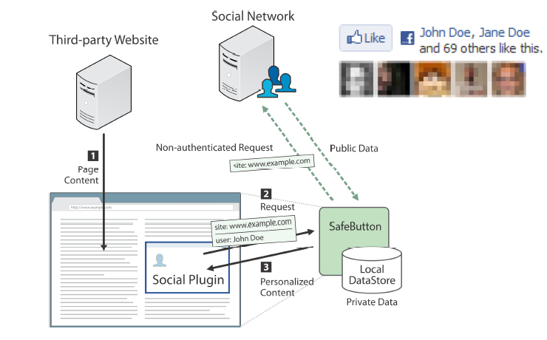
Privacy-Preserving Social Plug-ins

Slide 12


The SafeButton Browser Extension
Disables the original social plug-ins
SafeButton DOM replacement preserve the same (personalized) content
Upon interaction, the original plug-in is loaded to enable write functionality

Slide 13
SafeButton’s Bootstrapping
Privacy protected from the beginning
Downloading social data upon user’s login to social network service
Bootstrapping the local store for 5,000 friends took a little less than 10 hours
Periodic, incremental updates

Slide 14
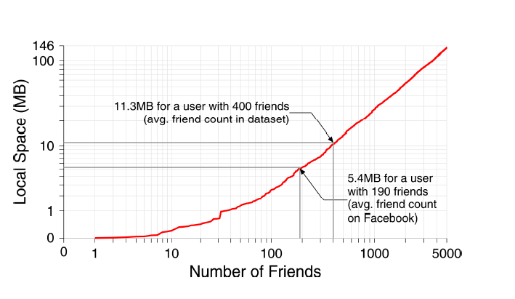
SafeButton’s Resource Requirements

Slide 15
SafeButton As a Service
Web browser extensions are not good enough
  Users unaware of privacy risks of social plug-ins
  Users unwilling or unable to install extensions
Implemented with Web technologies that enable an in-browser solution without additional software

Slide 16
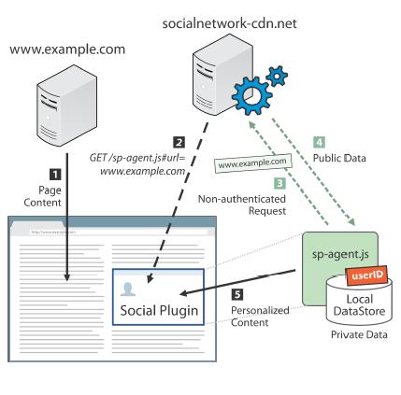
SafeButton As a Service
Pages incl. social
plug-ins as usual
Social network will return
a SafeButton agent

Slide 17
SafeButton As a Service
How to avoid leaking user-identifying info?
  Isolate social plug-ins to diff. domain
  Secure message passing with SNS
  Cacheable agent
  Encrypt data store

Slide 18
Summary
Identified privacy issues of current social plug-ins that most users aren’t aware of
Pointed out the dilemma between privacy and functionality
Presented the proposal for privacy-preserving social plug-ins

