Slide 1
I Still Know What You Visited Last Summer
User Interaction And Side Channel Attacks On Browser History
Zachary Weinberg
Eric Y. Chen
Pavithra Ramesh Jayaraman
Collin Jackson
IEEE Symposium on Security and Privacy, May 2011

Slide 2
Introduction : History Sniffing
Unintended consequence of combination of three independently desirable features
  Visited-link indication to the user
  CSS control of all aspects of page appearance
  JavaScript monitoring of page rendering

Slide 3
How can history sniffing be used?
Benign:
  Websites could use history sniffing to determine whether their users have visited known phishing sites.
  Websites could seed visitors’ history with URLs made up for the purpose, and use the URLs to re-identify their visitors.
Malicious:
  Track visitors across sites for advertising purpose, determining whether they also visit a site’s competitors.
  Attackers can construct more targeted phishing pages, by impersonating only sites that a particular victim is known to visit

Slide 4
Automated attacks

Slide 5
Direct Sniffing
Javascript checks link colour through Document Object Model (DOM)
DOM uses “computed style” of HTML element to collect CSS properties
Malicious site can create hyperlinks for some sites and can then check if those links have indeed been visited by user

Slide 6
Indirect Sniffing
Make visited and unvisited links take different amounts of space, which causes unrelated elements on the page to move; inspect the positions of those other elements.
Make visited and unvisited links cause different images to load.

Slide 7
Side Channel Attacks
Timing attacks
  Attacker can make the page take longer to lay out if a link is visited than if it is unvisited

Slide 8
Defense against History Sniffing
L. David Baron, 2010
  Make getComputedStyle act as though all links are unvisited
  Request all images mentioned in CSS at once
  Limit the CSS properties that can be used to style visited links to color, background-color, border-color, outline-color, column-rule-color, fill, and stroke

Slide 9
Interactive Attacks

Slide 10
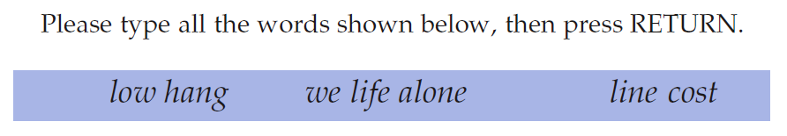
Word CAPTCHA
Each word is a hyperlink to an URL that the attacker wishes to probe
If unvisited, it is drawn in the same color as the background

Slide 11
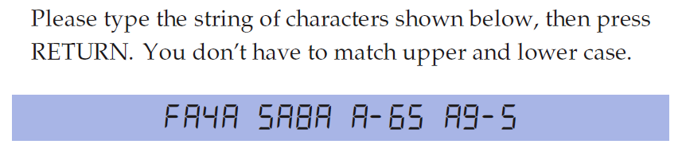

Character CAPTCHA
Seven-segment LCD symbols
Every letter represents 3 URLs

Slide 12
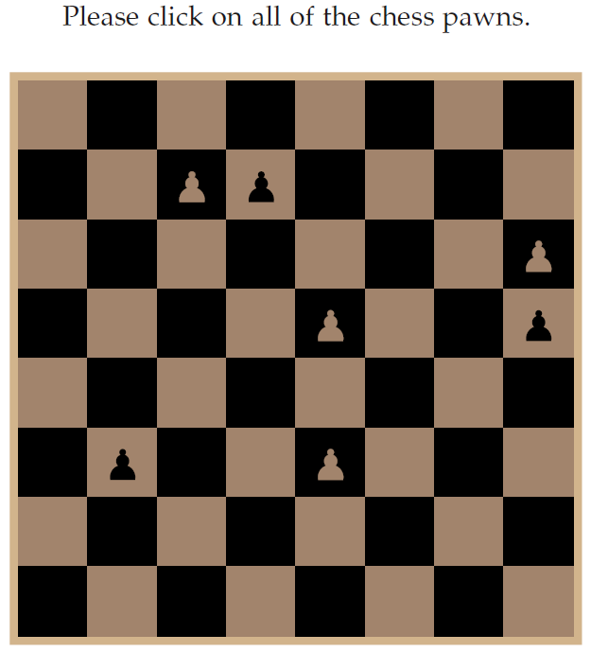
Chessboard Puzzle
Each square contains a URL
Only the pawns corresponding to visited sites are made visible

Slide 13
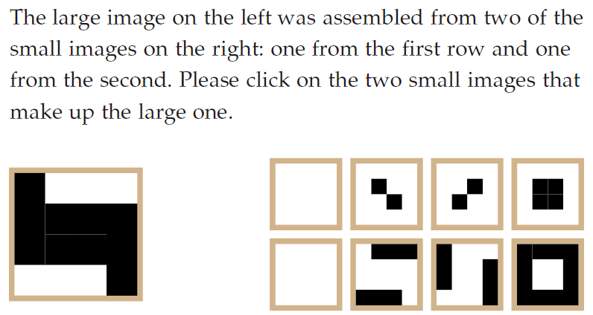
Pattern Matching Puzzle

Slide 14
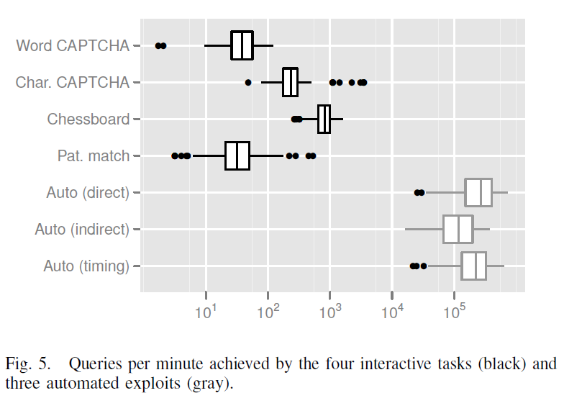
Success Rate

Slide 15
Conclusion
Automated history sniffing attacks have successfully been blocked by Baron’s solution
Interactive attacks cannot be blocked

Slide 16
References
L. D. Baron. (2002) :visited support allows queries into global history. Mozilla bug 147777.
D. Jang, R. Jhala, S. Lerner, and H. Shacham, “An Empirical Study of Privacy-Violating Information Flows in JavaScript Web Applications,” in ACM Conference on Computer and Communications Security (CCS), 2010

