Slide 1
Exploring usability effects of increasing security in click-based graphical passwords
Elizabeth Stobert, Alain Forget,
Sonia Chiasson,
Paul C. van Oorschot, Robert Biddle

Slide 2
Authentication Methods
Token based authentication(which you have)
Biometric based authentication(which you are)
Knowledge based (which you know)
  Text Based
  Graphical Password
    Recognition based
    Recall based
      Repeat a drawing
      Repeat a sequence of action

Slide 3
Why use Graphical Password?
Human can remember pictures better than text
Text Password
  memorable passwords easy for attackers to guess, but strong system-assigned passwords diﬃcult for users to remember
  Reusing same passwords across many accounts increases the potential impact if one account is compromised.
Biometric based authentications
  Expensive and inconvenient
  Biometric information is part of a person’s identity leads to privacy concern

Slide 4
Persuasive Cued Click-Points (PCCP)
Click-Points
  one click-point on different images shown in sequence
Cued
  Next image displayed is based on the location of the previously entered click-point
Persuasive
  encouraging users to select more random point, and hence more difficult to guess, click-points.

Slide 5
Login in PCCP System
Sequence of images is presented
User must choose one click-point per image
First image assigned by the system, but subsequent image is determined by the user’s previous click.
It provides users feedback about the correctness of password entry at every attempt
  User see correct image only after clicking in correct tolerance square of previous image
  Not useful for attacker who don’t know the correct image sequence

Slide 6
Registration in PCCP
Sequence of images is presented
Each image have a randomly highlighted region called viewport
User has to choose a point within viewport
Shuffle button is provided to change the position of viewport to a random position
User can use shuffle button if he unable to find a memorable point within current viewport
Random viewport persuades user to choose point at random location.
Thus increases security

Slide 7
Text Password vs PCCP
Theoretical Password Space,(TPS) :- Total number of unique password can be generated according to system specification
For Text Password
  TPS = 95^{n}
    95 number of typeable character on US keyboard
    n is length of password
For PCCP
  TPS = ((w * h)/t²)^{c}
    w*h :- size of image in pixel
    t² :- size of tolerance square
    c :- number of click-points

Slide 8
TPS of an 8-character password is (2⁵³ or 53 bits)
which is equal to PCCP password of
  small image size (451 x 331) pixel and 6 click-points
  Large image size (800 x 600) pixel and 5 click-points
So PCCP provide equal password space as of Text password.

Slide 9
Usability
Large images and more click-point increases the theoretical password space but decreases usability.
Achieve better usability & memorability for approximately equivalent password space.
Hypothesis:
  Increasing the number of click-points will decrease usability.
  Increasing the size of the image will decrease usability.
  For conditions with approximately comparable theoretical password spaces, the condition with the larger image size will have better usability

Slide 10
Experiment
A between-subjects design was used, and the 82 participants (47 females and 35 males) were randomly assigned.
Participants created and re-entered PCCP password for six fictitious accounts.
In their second session, participants tried to re-enter these same six passwords.

Slide 11
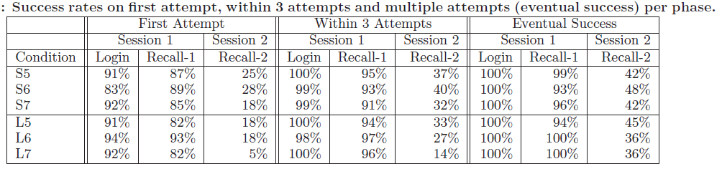
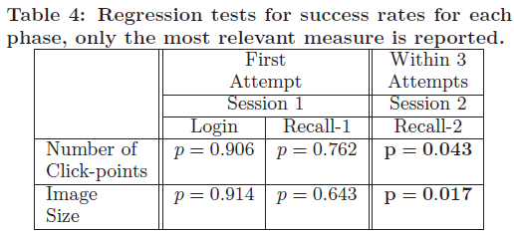
Usability Results
Success Rates
Lower value of p in session-2 supports both the Hypothesis 1 & 2.

Slide 12
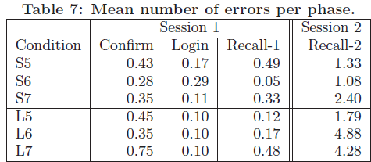
Usability Results
Time spent on creating and entering password increases with the click-points.
Errors
  According to mean errors shown in table, large images causes users to make more mistakes.

Slide 13
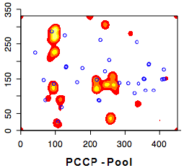
ANALYSIS OF PASSWORD DISTRIBUTIONS
Click-point clustering
  Passwords should be as random as possible while still maintaining memorability.
  Different users tend to select similar click-points creating what are known as hotspots.

Slide 14
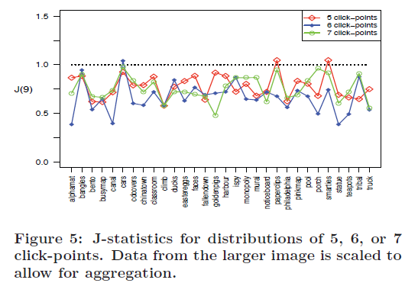
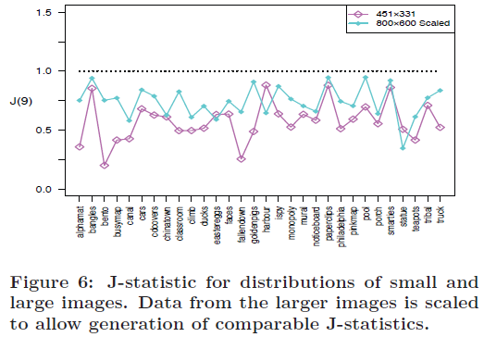
Click-point clustering
Test indicates significantly less clustering for larger images.

Slide 15
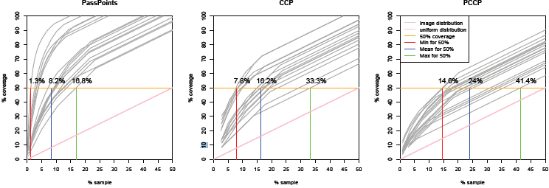
Hotspot coverage
PCCP is close enough to a randomly distributed click-points (straight diagonal line);
Viewport and shuffling reduces hotspots in the image.

Slide 16
Security : Guessing Attack
Pattern-based attack
  automated pattern based dictionary attack that prioritizes passwords consisting of click-points ordered in a consistent horizontal and vertical direction.
  PCCP passwords are essentially indistinguishable from random for click-point distributions
Hotspot attack
  PassPoints passwords from a small number of users can be used to determine likely hotspots on an image, which can then be used to form an attack dictionary.
  For attacker, things are difficullt as hotspots reduced, sequence of images need to be determined,

Slide 17
Securiy : Capture Attacks
Shoulder-surfing
Malware
  Malware is a major concern for text and graphical passwords, since keylogger, mouse-logger, and screen scraper malware could send captured data remotely or otherwise make it available to an attacker.
Social engineering and phishing is more difficult for PCCP than for text passwords or PassPoints sue to PCCP’s multiple images.

Slide 18
Conclusion
Graphical passwords provide plausible alternatives to text based password and biometric authentications
It is generally more difficult to break graphical passwords using the traditional attack methods such as brute force search, dictionary attack, or spyware.

