Slide 1
Clickjacking: Attacks & Defences
Lin-Shung Huang, Alex Moshchuk, Helen Wang, Stuart Schechter, and Collin Jackson
Carnegie Mellon, Microsoft Research
USENIX Security 2012
SIL765 paper presentation by:
Rahul Goyal: 2008CS50222
Ravee Malla: 2008CS50224
Course Instructor:
Prof. Huzur Saran
CSE, IIT Delhi

Slide 2
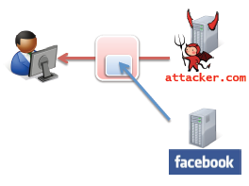
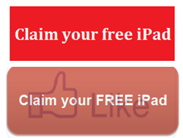
Likejacking
The user can be tricked into clicking button, on an attacker’s website
User visits attacker.com
Like button hidden behind another button

Slide 3
Clickjacking: Definition
Prerequisite: Multiple mutually distrusting applications sharing the same display, and having permission to manipulate each other’s visual appearance
Attacker comprimises context integrity of another app’s UI components
  Temporal Integrity
  Visual Integrity

Slide 4
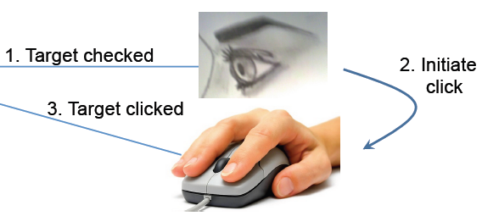

Types of Context Integrity
Visual Integrity
Temporal Integrity
What the user sees, is actually what is present
No transparent, overlayed objects
Eg should be visible
should be visible
State of the UI between time of user checking and the time of initiating the click, remains the same

Slide 5


Compromising Visual Integrity
Hide the target
Partial Overlays

Slide 6
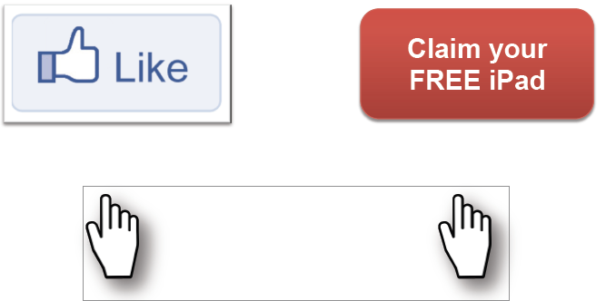
Compromising Visual Integrity
Multiple cursor feedback known as cursorjacking
Real Cursor
Fake Cursor

Slide 7
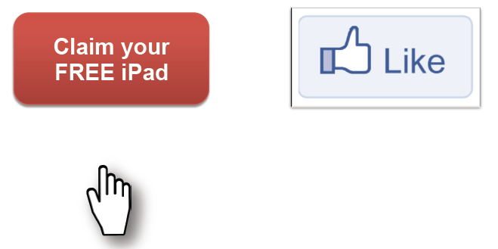
Compromising Temporal Integrity
Bait and switch: As mouse comes near “Claim you..” button, Like moves to take it’s location before the user realizes it

Slide 8
Existing Defences
User confirmation
  Degrades user experience
UI randomization
  Unreliable & not user-friendly. (Multi-click attacks)
Framebusting (X-Frame-Options)
  Incompatible with embedding 3rd-party widgets
Opaque overlay policy
  Breaks legitimate sites
Visibility detection on click
  Allow clicks only on elements that are visible

Slide 9
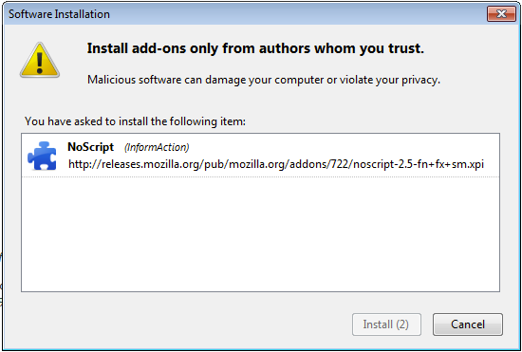
Protecting temporal integrity
Imposing a delay after displaying a UI
  Annoying to users

Slide 10
New Attacks Demonstrated
Authors conducted new exploits using Clickjacking & with and without their own patches using Amazon Mechanical Turks
Reported the effectiveness of the attack
Attacks:
  Accessing user’s webcam: Attack success: 43%
  Stealing user’s email: Attack success: 47%
  Revealing user’s identity: Attack success: 98%

Slide 11
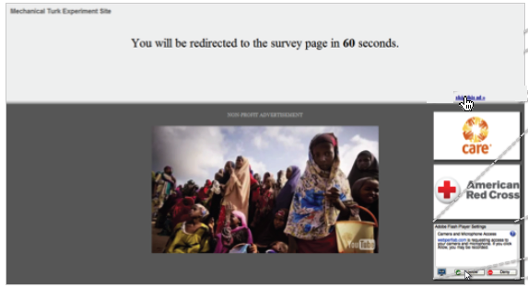
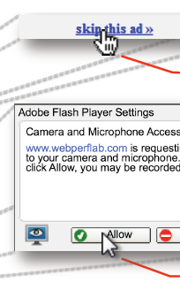
Accessing user’s webcam
Fake Cursor
Real Cursor

Slide 12
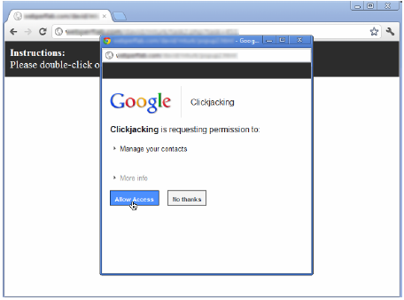
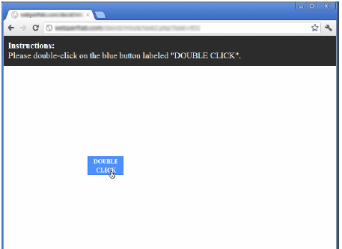
Stealing user’s email

Slide 13
InContext Defence
Design Goals:
  Should support 3rd party object embedding
  Should not have to prompt users for actions
  Should not break existing sites
  Should be resilient to new attacks

Slide 14
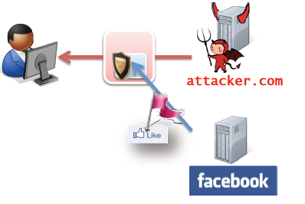
Basic Idea
Techniques to ensure user is always InContext of the sensitive UI in interaction
Websites can indicate their sensitive UI
Browsers can enforce context integrity rules on these sensitive UIs

Slide 15
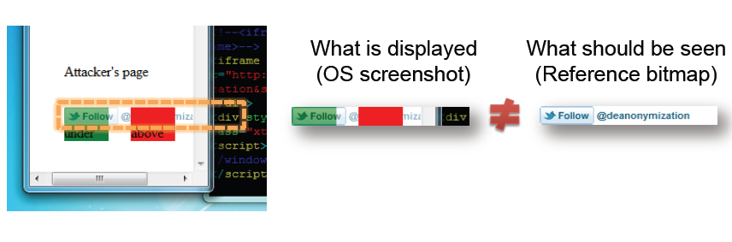
Ensuring visual integrity of target
OS can compare the screenshot of sensitive UI with the reference bitmap provided
  30ms overhead on click processing

Slide 16
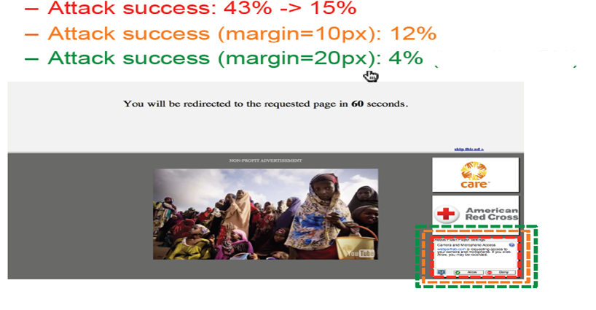
Ensuring visual integrity of pointer
Remove cursor customization
Freeze screen

Slide 17
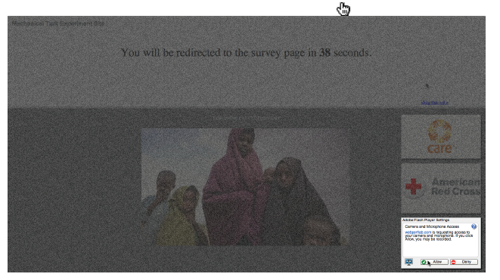
Ensuring visual integrity of pointer
Lightbox effect around target on pointer entry

Slide 18
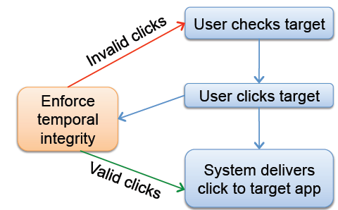
Ensuring temporal integrity
UI Delay
  On a visual change, all buttons are inactive for a certain time
Pointer Re-entry:
  On a visual change, invalidate clicks till pointer re-enters the UI

Slide 19
Conclusions & Extensions
Demonstrate clickjacking variants and dangers
Show effective defences (success 43-98%)
Our Extensions:
  Replicate the studies and test the effectiveness of defences
  Explore other methods/cases where Clickjacking can be used as an exploit

Slide 20
Thanks
Questions & Comments.

