Slide 1
MapReduce
Parallel Computing
MapReduce
Examples
Parallel Efficiency
Assignment

Slide 2

Parallel Computing
Parallel efficiency with p processors
Traditional parallel computing:
  focus on compute intensive tasks
  often ignores disk read and write
  focus on inter-processor n/w communication overheads
  assumes a “shared-nothing” model

Slide 3
Parallel Tasks on Large Distributed Files
Files are distributed in a GFS-like system
Files are very large – many terabytes
Reading and writing to disk (GFS) is a significant part of T
Computation time per data item are not large
All data can never be in memory, so appropriate algorithms are needed

Slide 4
MapReduce
MapReduce is both a programming model and a clustered computing system
  A specific way of formulating a problem, which yields good parallelizability esp in the context of large distributed data
  A system which takes a MapReduce-formulated problem and executes it on a large cluster
  Hides implementation details, such as hardware failures, grouping and sorting, scheduling …

Slide 5
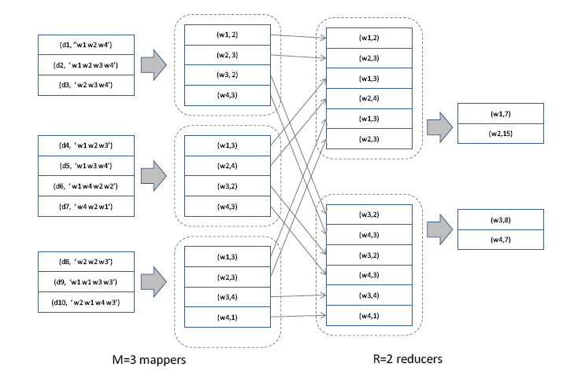
Word-Count using MapReduce
Problem: determine the frequency of each word in a large document collection

Slide 6


Map: document -> word-count pairs
Reduce: word, count-list -> word-count-total

Slide 7


General MapReduce Formulation of a Problem
Map:
  Preprocesses a set of files to generate intermediate key-value pairs
  As parallelized as you want
Group:
  Partitions intermediate key-value pairs by unique key, generating a list of all associated values
Reduce:
  For each key, iterates over value list
  Performs computation that requires context between iterations
  Parallelizable amongst different keys, but not within one key
Notes:
A common question is: how is map reduce different from cloning the input data N ways, and using N workers to process the data using the original non-MR formulation/

Slide 8
MapReduce Parallelization: Execution
Shamelessly stolen from Jeff Dean’s OSDI ‘04 presentation
http://labs.google.com/papers/mapreduce-osdi04-slides/index.html

Slide 9
MapReduce Parallelization: Pipelining
Finely granular tasks: many more map tasks than machines
  Better dynamic load balancing
  Minimizes time for fault recovery
  Can pipeline the shuffling/grouping while maps are still running
Example: 2000 machines -> 200,000 map + 5000 reduce tasks
Shamelessly stolen from Jeff Dean’s OSDI ‘04 presentation
http://labs.google.com/papers/mapreduce-osdi04-slides/index.html

Slide 10
MR Runtime Execution Example
The following slides illustrate an example run of MapReduce on a Google cluster
A sample job from the indexing pipeline, processes ~900 GB of crawled pages

Slide 11
MR Runtime (1 of 9)
Shamelessly stolen from Jeff Dean’s OSDI ‘04 presentation
http://labs.google.com/papers/mapreduce-osdi04-slides/index.html

Slide 12
MR Runtime (2 of 9)
Shamelessly stolen from Jeff Dean’s OSDI ‘04 presentation
http://labs.google.com/papers/mapreduce-osdi04-slides/index.html

Slide 13
MR Runtime (3 of 9)
Shamelessly stolen from Jeff Dean’s OSDI ‘04 presentation
http://labs.google.com/papers/mapreduce-osdi04-slides/index.html

Slide 14
MR Runtime (4 of 9)
Shamelessly stolen from Jeff Dean’s OSDI ‘04 presentation
http://labs.google.com/papers/mapreduce-osdi04-slides/index.html

Slide 15
MR Runtime (5 of 9)
Shamelessly stolen from Jeff Dean’s OSDI ‘04 presentation
http://labs.google.com/papers/mapreduce-osdi04-slides/index.html

Slide 16
MR Runtime (6 of 9)
Shamelessly stolen from Jeff Dean’s OSDI ‘04 presentation
http://labs.google.com/papers/mapreduce-osdi04-slides/index.html

Slide 17
MR Runtime (7 of 9)
Shamelessly stolen from Jeff Dean’s OSDI ‘04 presentation
http://labs.google.com/papers/mapreduce-osdi04-slides/index.html

Slide 18
MR Runtime (8 of 9)
Shamelessly stolen from Jeff Dean’s OSDI ‘04 presentation
http://labs.google.com/papers/mapreduce-osdi04-slides/index.html

Slide 19
MR Runtime (9 of 9)
Shamelessly stolen from Jeff Dean’s OSDI ‘04 presentation
http://labs.google.com/papers/mapreduce-osdi04-slides/index.html

Slide 20
Examples: MapReduce @ Facebook
Types of Applications:
  Summarization
    Eg: Daily/Weekly aggregations of impression/click counts
    Complex measures of user engagement
  Ad hoc Analysis
    Eg: how many group admins broken down by state/country
  Data Mining (Assembling training data)
    Eg: User Engagement as a function of user attributes
  Spam Detection
    Anomalous patterns
    Application api usage patterns
  Ad Optimization
  Too many to count ..

Slide 21
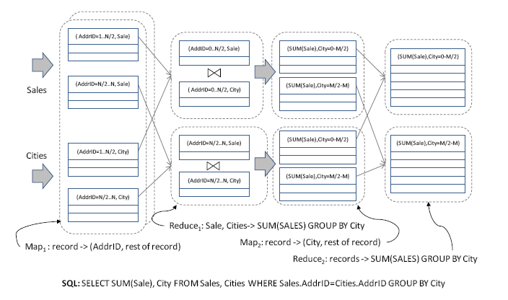
SQL Join using MapReduce

Slide 22
HaDoop MapReduce (Yahoo!)
Data is stored in HDFS (Hadoop’s version of GFS) or disk
Hadoop MR interface:
  The f_{m} and f_{r} are function objects (classes)
  Class for f_{m} implements the Mapper interface
    Map(WritableComparable key, Writable value,
    OutputCollector output, Reporter reporter)
  Class for f_{r} implements the Reducer interface
  reduce(WritableComparable key, Iterator values,
  OutputCollector output, Reporter reporter)
Hadoop takes the generated class files and manages running them

Slide 23
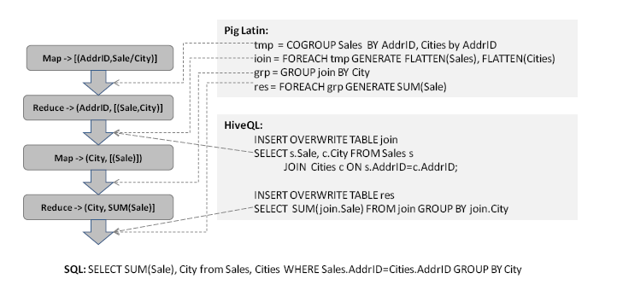
Pig Latin and Hive: MR Languages
Pig Latin – Yahoo!
Hive - Facebook

Slide 24
Example using Pig
Find sessions that end with the “best” page.
Visits
Pages
user | url | time
Amy | www.cnn.com | 8:00
Amy | www.crap.com | 8:05
Amy | www.myblog.com | 10:00
Amy | www.flickr.com | 10:05
Fred | cnn.com/index.htm | 12:00
url | pagerank
www.cnn.com | 0.9
www.flickr.com | 0.9
www.myblog.com | 0.7
www.crap.com | 0.2
. . .
. . .

Slide 25
In Pig Latin
Visits = load ‘/data/visits’ as (user, url, time);
Visits = foreach Visits generate user, Canonicalize(url), time;
Pages = load ‘/data/pages’ as (url, pagerank);
VP = join Visits by url, Pages by url;
UserVisits = group VP by user;
Sessions = foreach UserVisits generate flatten(FindSessions(*));
HappyEndings = filter Sessions by BestIsLast(*);
store HappyEndings into '/data/happy_endings';

Slide 26
Pig Latin vs. Map-Reduce
Map-reduce welds together 3 primitives:
  process records → create groups → process groups
  a = FOREACH input GENERATE flatten(Map(*));
  b = GROUP a BY $0;
  c = FOREACH b GENERATE Reduce(*);
In Pig, these primitives are:
  explicit
  independent
  fully composable
Pig adds primitives for:
  filtering tables
  projecting tables
  combining 2 or more tables
more natural programming model
optimization opportunities

Slide 27
Example cont.
Find users who tend to visit “good” pages.
Load
Visits(user, url, time)
Load
Pages(url, pagerank)
Transform
to (user, Canonicalize(url), time)
Join
url = url
Group
by user
Transform
to (user, Average(pagerank) as avgPR)
Filter
avgPR > 0.5

Slide 28
Load
Visits(user, url, time)
Load
Pages(url, pagerank)
(Amy, cnn.com, 8am)
(Amy, http://www.snails.com, 9am)
(Fred, www.snails.com/index.html, 11am)
(www.cnn.com, 0.9)
(www.snails.com, 0.4)
Transform
to (user, Canonicalize(url), time)
Join
url = url
(Amy, www.cnn.com, 8am)
(Amy, www.snails.com, 9am)
(Fred, www.snails.com, 11am)
(Amy, www.cnn.com, 8am, 0.9)
(Amy, www.snails.com, 9am, 0.4)
(Fred, www.snails.com, 11am, 0.4)
Group
by user
(Amy, { (Amy, www.cnn.com, 8am, 0.9),
(Amy, www.snails.com, 9am, 0.4) })
(Fred, { (Fred, www.snails.com, 11am, 0.4) })
Transform
to (user, Average(pagerank) as avgPR)
(Amy, 0.65)
(Fred, 0.4)
Filter
avgPR > 0.5
(Amy, 0.65)

Slide 29
Exercise (in groups)
Generate at least 50K random sentences of max length 140 characters from a set of 20-30 words
  Challenge version: download at least 50K tweets using Twitter’s APIs
Find all sets of sentences that are 90% similar to each other, i.e. 90% of the words match
  Formulate using MapReduce and implement in parallel
  Challenge version: use Google Scholar to find an efficient algorithm for the above (it exists)
  Challenge ++: implement the above in parallel using MR
(Use Hadoop on AWS)

Slide 30



Parallel Efficiency of MR
Execution time on single processor:
Parallel execution efficiency on P processors
Therefore is important leading to the need for an additional intermediate ‘combine’ stage

Slide 31
Word-Count using MapReduce
Mappers are also doing a ‘combine’ by computing the local word count in their respective documents

