Slide 1
Sampling in Space Restricted Settings
Anup Bhattacharya
IIT Delhi
Joint work with Davis Issac (MPI), Ragesh Jaiswal (IITD) and Amit Kumar (IITD)

Slide 2
Introduction: Sampling
Select a subset of data
Computations on “representative” subset would approximate computations on whole data
Sampling variants:
  Uniform sampling
  Weighted sampling
Study sampling algorithms with limited space

Slide 3
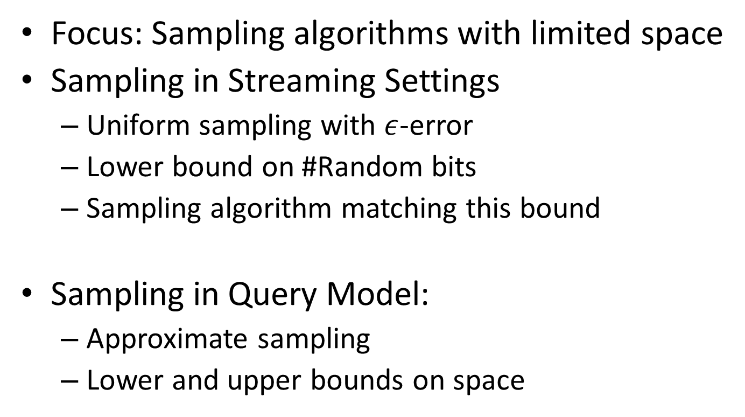
Outline
Focus: Sampling algorithms with limited space
Sampling in Streaming Settings
  Uniform sampling with $ε$-error
  Lower bound on #Random bits
  Sampling algorithm matching this bound
Sampling in Query Model:
  Approximate sampling
  Lower and upper bounds on space

Slide 4
Sampling in Streaming Settings

Slide 5
Sampling in Streaming Settings
Streaming Settings: The Model
  Items/objects arrive in online fashion
  #Total items not known in advance
  Typically poly(log(n)) space allowed
  One/multi-pass, space usage, time/item, overall time complexity, randomness, accuracy of output

Slide 6
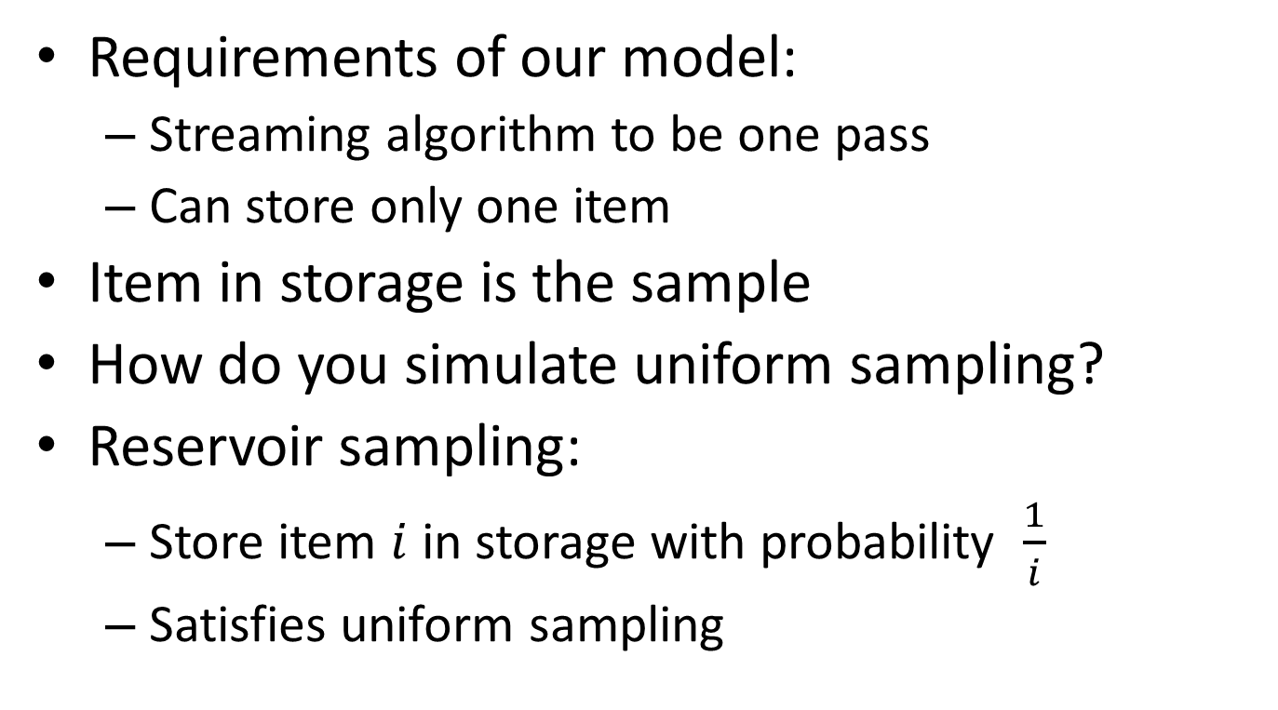
Sampling in Streaming Settings
Requirements of our model:
  Streaming algorithm to be one pass
  Can store only one item
Item in storage is the sample
How do you simulate uniform sampling?
Reservoir sampling:
  Store item $i$ in storage with probability $\frac{1}{i}$
  Satisfies uniform sampling

Slide 7



Reservoir Sampling
…
With probability $\frac{1}{i}$
With probability $1−\frac{1}{i}$
Store
Throw it away

Slide 8
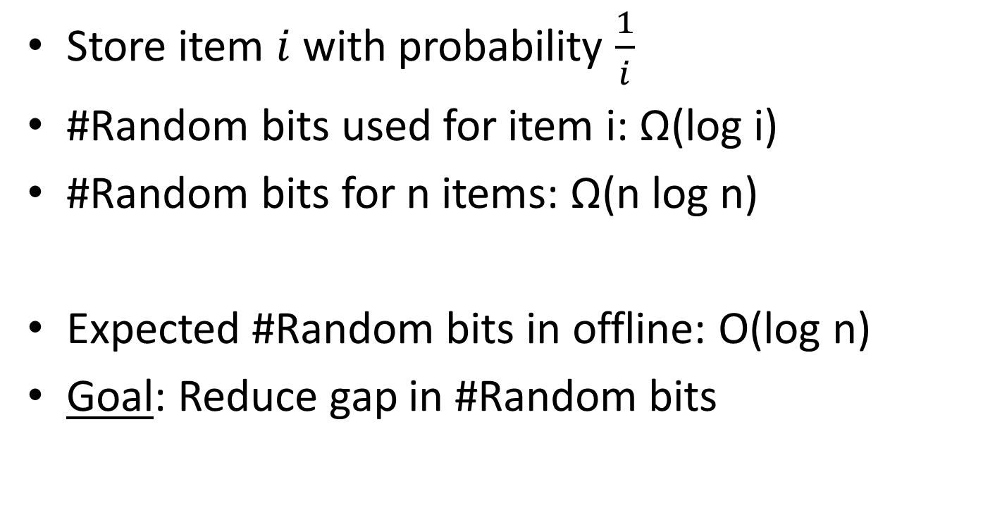
Reservoir Sampling
Store item $i$ with probability $\frac{1}{i}$
#Random bits used for item i: Ω(log i)
#Random bits for n items: Ω(n log n)
Expected #Random bits in offline: O(log n)
Goal: Reduce gap in #Random bits

Slide 9
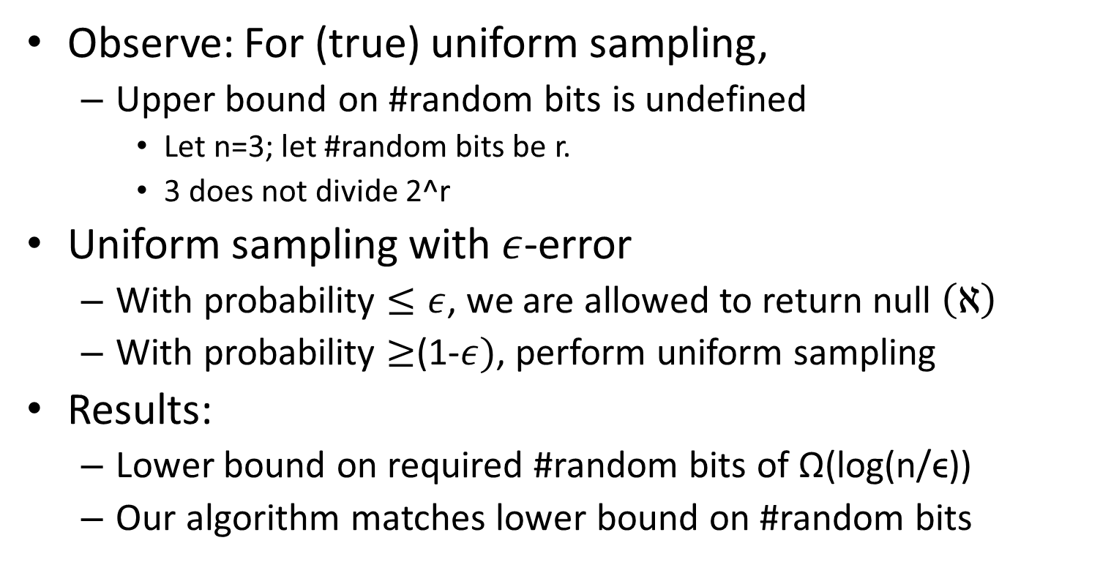
Uniform Sampling with ϵ-error
Observe: For (true) uniform sampling,
  Upper bound on #random bits is undefined
    Let n=3; let #random bits be r.
    3 does not divide 2^r
Uniform sampling with $ε$-error
  With probability $≤ε$, we are allowed to return null $\left(ℵ\right)$
  With probability $≥$(1-$ε)$, perform uniform sampling
Results:
  Lower bound on required #random bits of Ω(log(n/ϵ))
  Our algorithm matches lower bound on #random bits

Slide 10
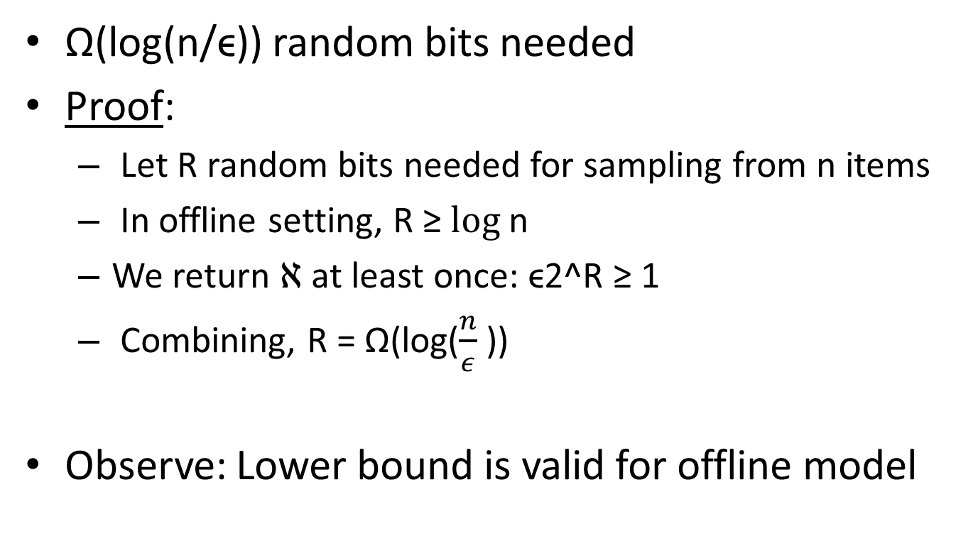
Lower Bound on Sampling with ϵ-error
Ω(log(n/ϵ)) random bits needed
Proof:
  Let R random bits needed for sampling from n items
  In offline setting, R ≥ $log$n
  We return $ℵ$ at least once: ϵ2^R ≥ 1
  Combining, R = Ω(log($\frac{n}{ε}$))
Observe: Lower bound is valid for offline model

Slide 11
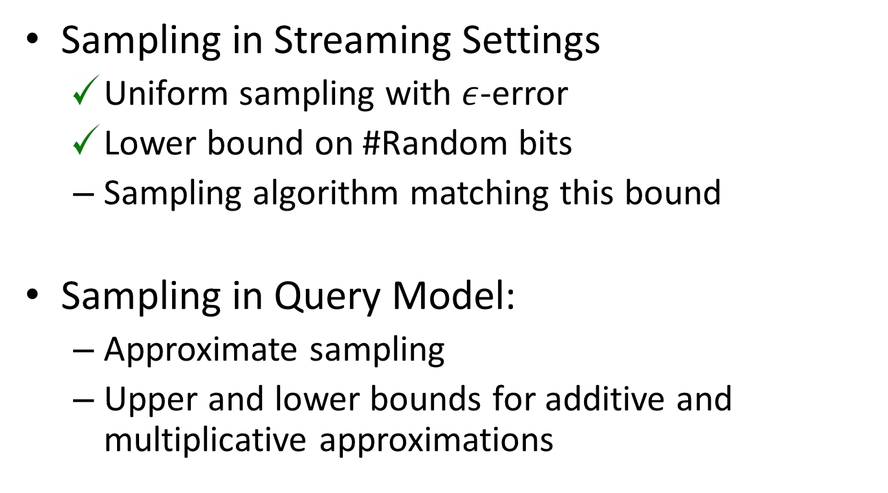

Outline
Sampling in Streaming Settings
  Uniform sampling with $ε$-error
  Lower bound on #Random bits
  Sampling algorithm matching this bound
Sampling in Query Model:
  Approximate sampling
  Upper and lower bounds for additive and multiplicative approximations

Slide 12
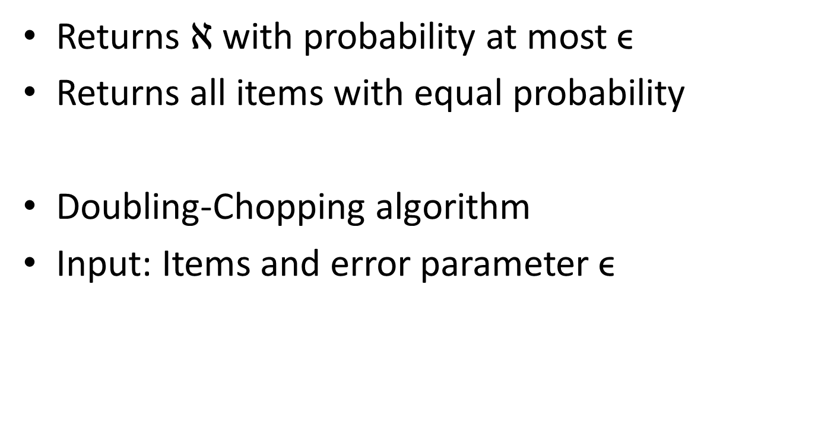
Algorithm for Uniform Sampling ϵ-error
Returns $ℵ$ with probability at most ϵ
Returns all items with equal probability
Doubling-Chopping algorithm
Input: Items and error parameter ϵ

Slide 13
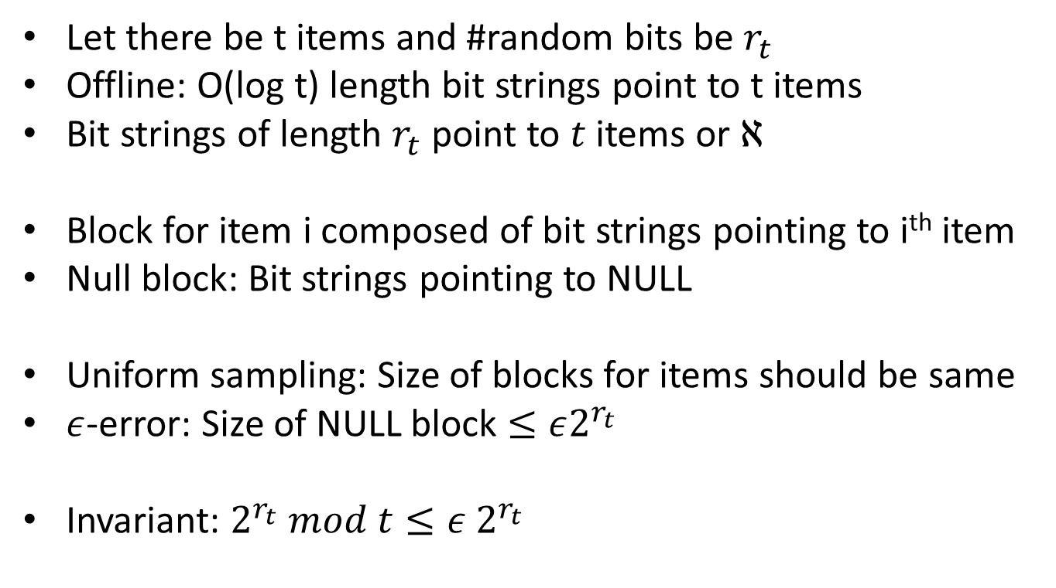
Doubling-Chopping Algorithm
Let there be t items and #random bits be $r_{t}$
Offline: O(log t) length bit strings point to t items
Bit strings of length $r_{t}$ point to $t$ items or $ℵ$
Block for item i composed of bit strings pointing to i^{th} item
Null block: Bit strings pointing to NULL
Uniform sampling: Size of blocks for items should be same
$ε$-error: Size of NULL block $≤ε2^{r_{t}}$
Invariant: $2^{r_{t}} mod t≤ε 2^{r_{t}}$

Slide 14

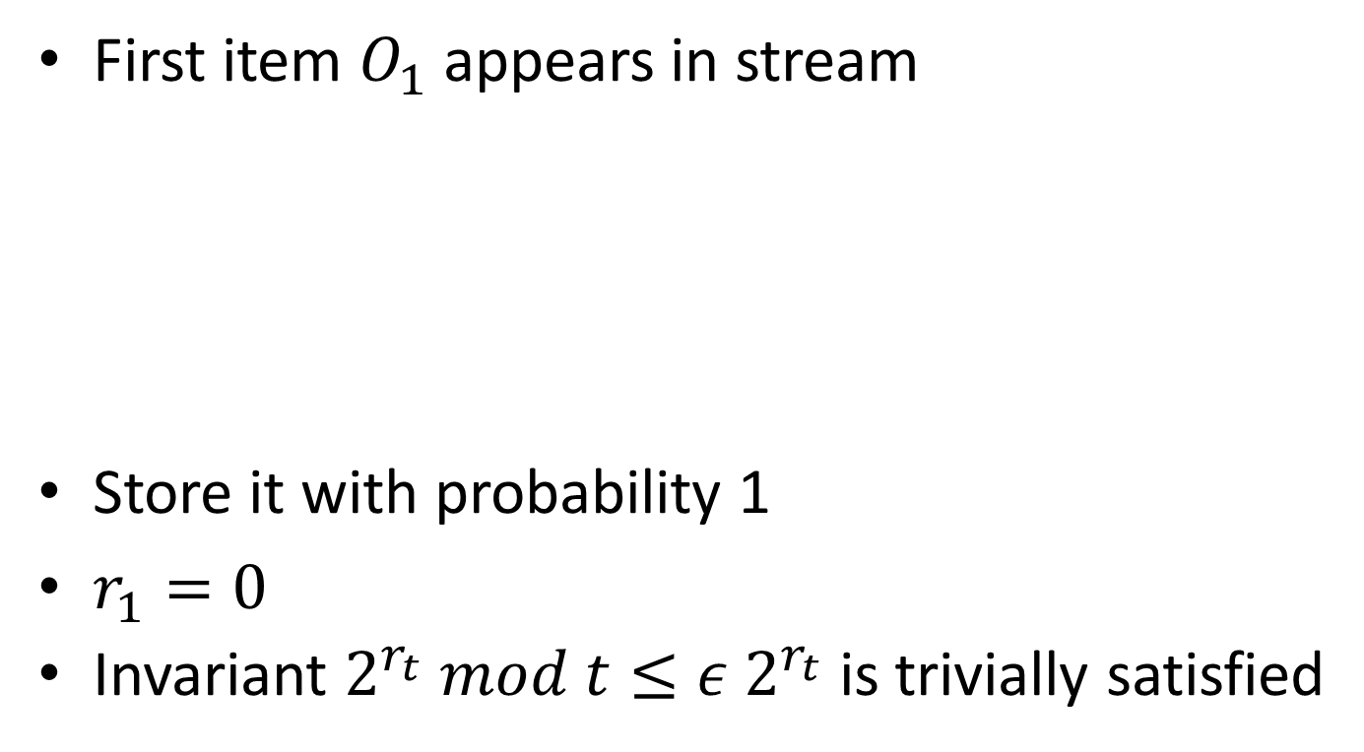
Doubling-Chopping algorithm, ϵ=1/16
First item $O_{1}$ appears in stream
Store it with probability 1
$r_{1}=0$
Invariant $2^{r_{t}} mod t≤ε 2^{r_{t}}$ is trivially satisfied
$$O_{1}$$

Slide 15
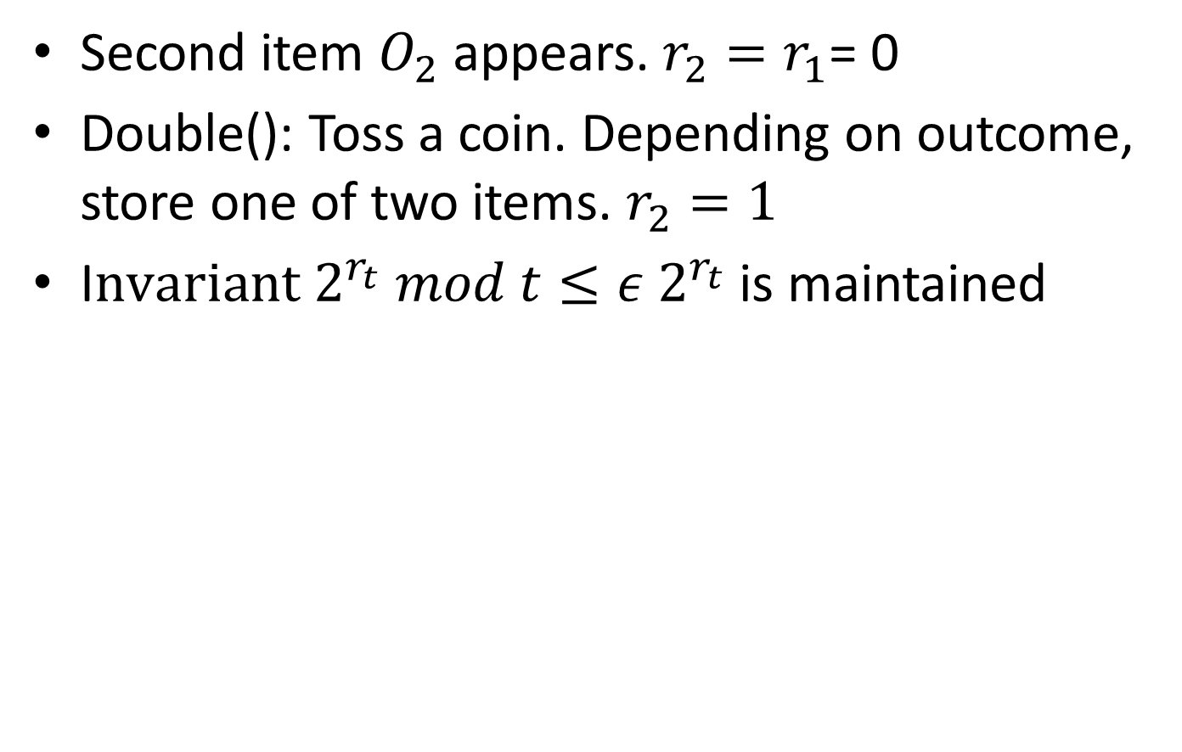


Doubling-Chopping algorithm, ϵ=1/16
Second item $O_{2}$appears. $r_{2}=r_{1}$= 0
Double(): Toss a coin. Depending on outcome, store one of two items. $r_{2}=1$
I$nvariant 2^{r_{t}} mod t≤ε 2^{r_{t}}$ is maintained
$$O_{1}$$
$$O_{2}$$
0
1

Slide 16
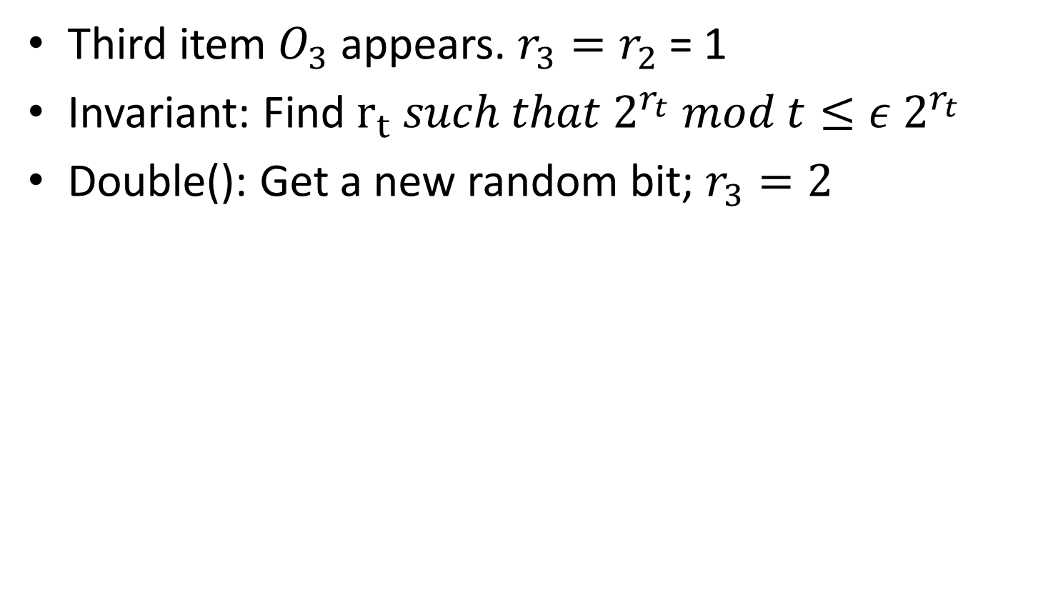




Doubling-Chopping algorithm, ϵ=1/16
Third item $O_{3}$ appears. $r_{3}=r_{2}$ = 1
Invariant: Find $r_{t}{ such that 2}^{r_{t}} mod t≤ε 2^{r_{t}}$
Double(): Get a new random bit; $r_{3}=2$
$$O_{1}$$
$$O_{2}$$
$$O_{3}$$
$$ℵ$$
00
10
01
11

Slide 17

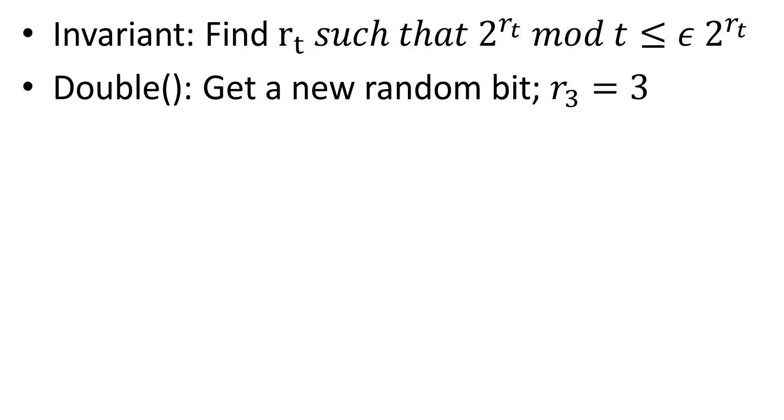

Doubling-Chopping algorithm, ϵ=1/16
Invariant: Find $r_{t}{ such that 2}^{r_{t}} mod t≤ε 2^{r_{t}}$
Double(): Get a new random bit; $r_{3}=3$
$$O_{1}$$
$$O_{2}$$
$$O_{3}$$
$$ℵ$$
000
010
100
110
001
011
101
111

Slide 18

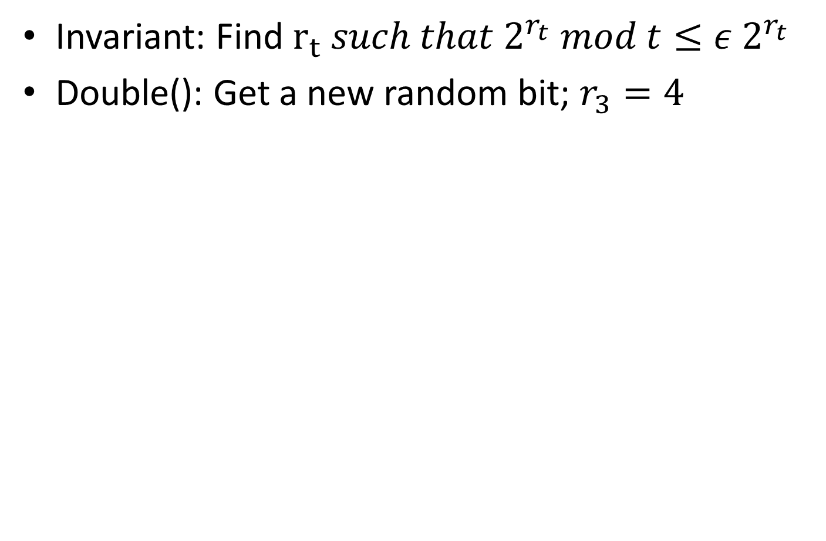



Doubling-Chopping algorithm, ϵ=1/16
Invariant: Find $r_{t}{ such that 2}^{r_{t}} mod t≤ε 2^{r_{t}}$
Double(): Get a new random bit; $r_{3}=4$
$$O_{1}$$
$$O_{2}$$
$$O_{3}$$
$$ℵ$$
0000
0010
0100
0110
1000
1010
1100
1110
0001
0011
0101
0111
1001
1011
1101
1111

Slide 19


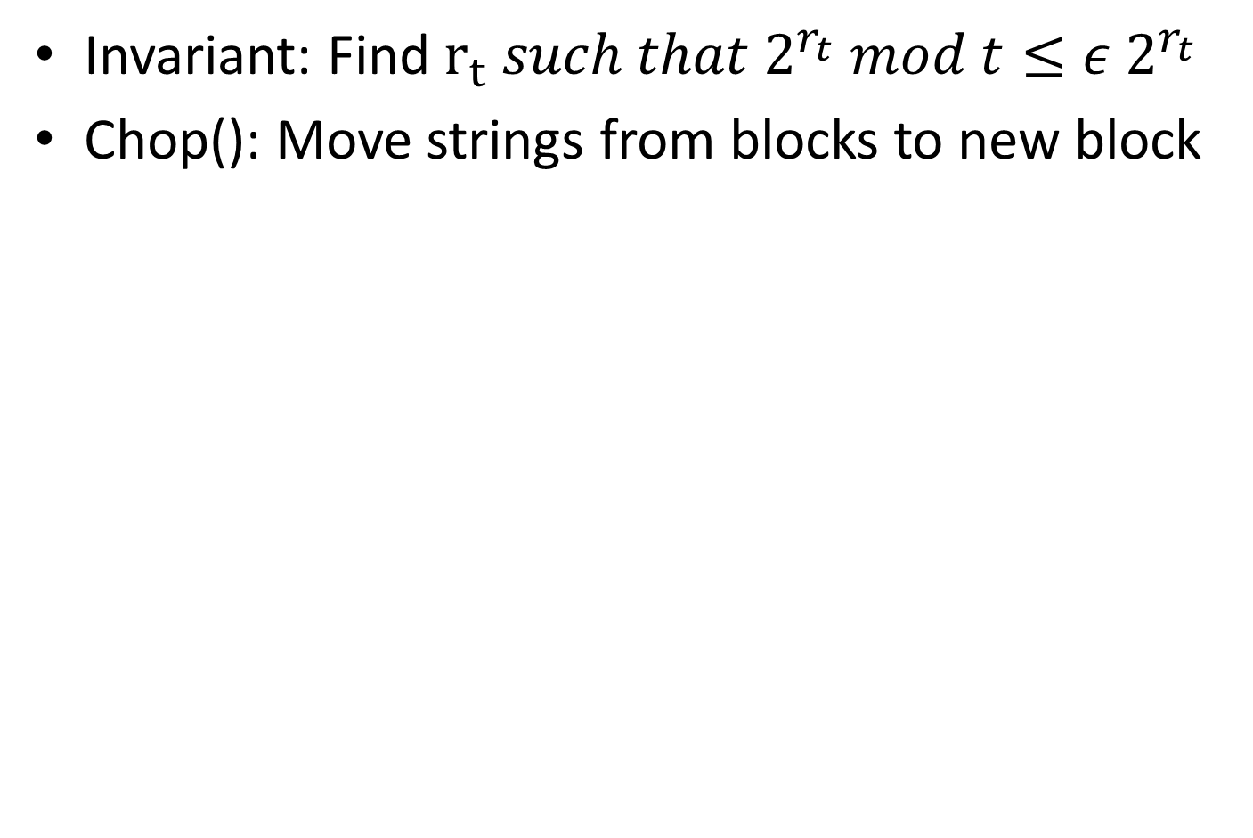


Doubling-Chopping algorithm, ϵ=1/16
Invariant: Find $r_{t}{ such that 2}^{r_{t}} mod t≤ε 2^{r_{t}}$
Chop(): Move strings from blocks to new block
$$O_{1}$$
$$O_{2}$$
$$O_{3}$$
$$ℵ$$
0000
0010
0100
0110
1000
1010
1100
1110
0001
0011
0101
0111
1001
1011
1101
1111

Slide 20




Doubling-Chopping algorithm, ϵ=1/16
Chop(): Move strings from blocks to new block
$$O_{1}$$
$$O_{2}$$
$$O_{3}$$
$$ℵ$$
0110
1000
1010
1100
1110
0111
1001
1011
1101
1111
0101
0011
0001
0100
0010
0000

Slide 21



Doubling-Chopping algorithm, ϵ=1/16
Chop(): Move strings from blocks to new block
$$O_{1}$$
$$O_{2}$$
$$O_{3}$$
$$ℵ$$
0110
1000
1010
1100
1110
0111
1001
1011
1101
1111
0101
0011
0001
0100
0010
0000

Slide 22



Doubling-Chopping algorithm, ϵ=1/16
Chop(): Move strings from blocks to new block
$$O_{1}$$
$$O_{2}$$
$$O_{3}$$
$$ℵ$$
0110
1000
1010
1100
1110
0111
1001
1011
1101
1111
0011
0001
0100
0010
0000
0101

Slide 23


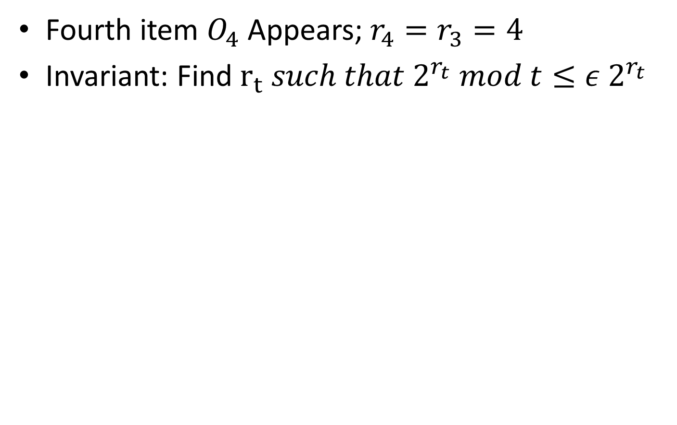



Doubling-Chopping algorithm, ϵ=1/16
Fourth item $O_{4}$ Appears; $r_{4}=r_{3}=4$
Invariant: Find $r_{t}{ such that 2}^{r_{t}} mod t≤ε 2^{r_{t}}$
$$O_{1}$$
$$O_{2}$$
$$O_{3}$$
$$O_{4}$$
$$ℵ$$
0110
1000
1010
1100
1110
0111
1001
1011
1101
1111
0011
0001
0100
0010
0000
0101

Slide 24





Doubling-Chopping algorithm, ϵ=1/16
$$O_{1}$$
$$O_{2}$$
$$O_{3}$$
$$O_{4}$$
$$ℵ$$
1000
1010
1100
1110
1001
1011
1101
1111
0001
0100
0010
0000
0101
0011
0111
0110

Slide 25




Doubling-Chopping algorithm, ϵ=1/16
$$O_{1}$$
$$O_{2}$$
$$O_{3}$$
$$O_{4}$$
$$ℵ$$
1000
1010
1100
1110
1001
1011
1101
1111
0001
0100
0010
0000
0101
0011
0111
0110

Slide 26
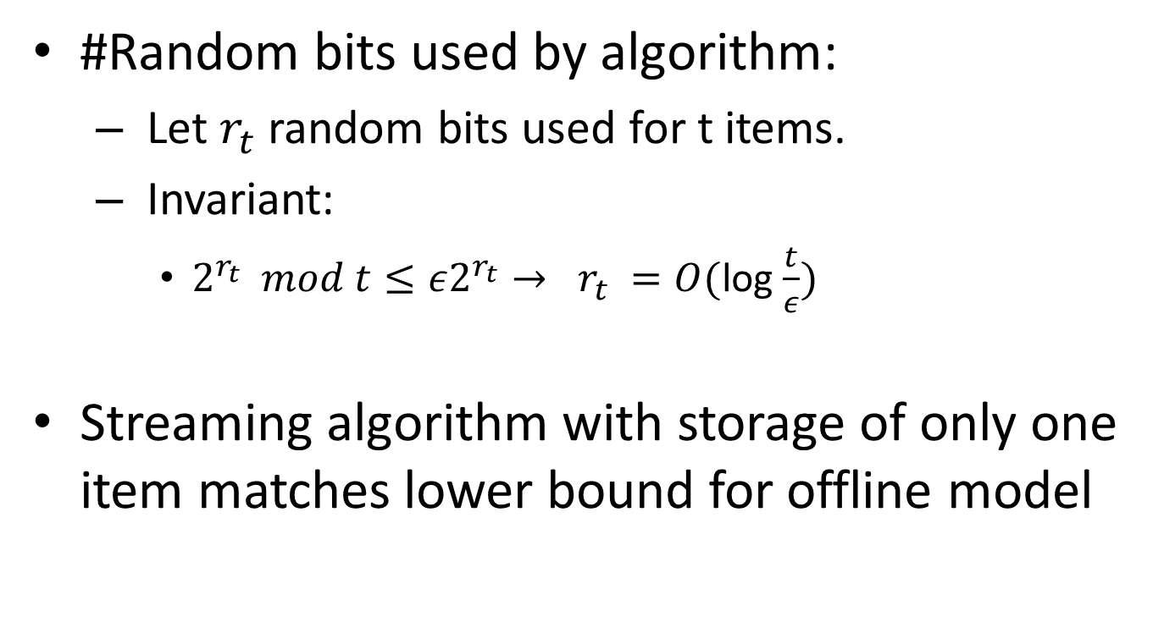
Algorithm Analysis
#Random bits used by algorithm:
  Let $r_{t}$ random bits used for t items.
  Invariant:
    $2^{r_{t}} mod t≤ε2^{r_{t}}→ r_{t} =O($log $\frac{t}{ε})$
Streaming algorithm with storage of only one item matches lower bound for offline model

Slide 27
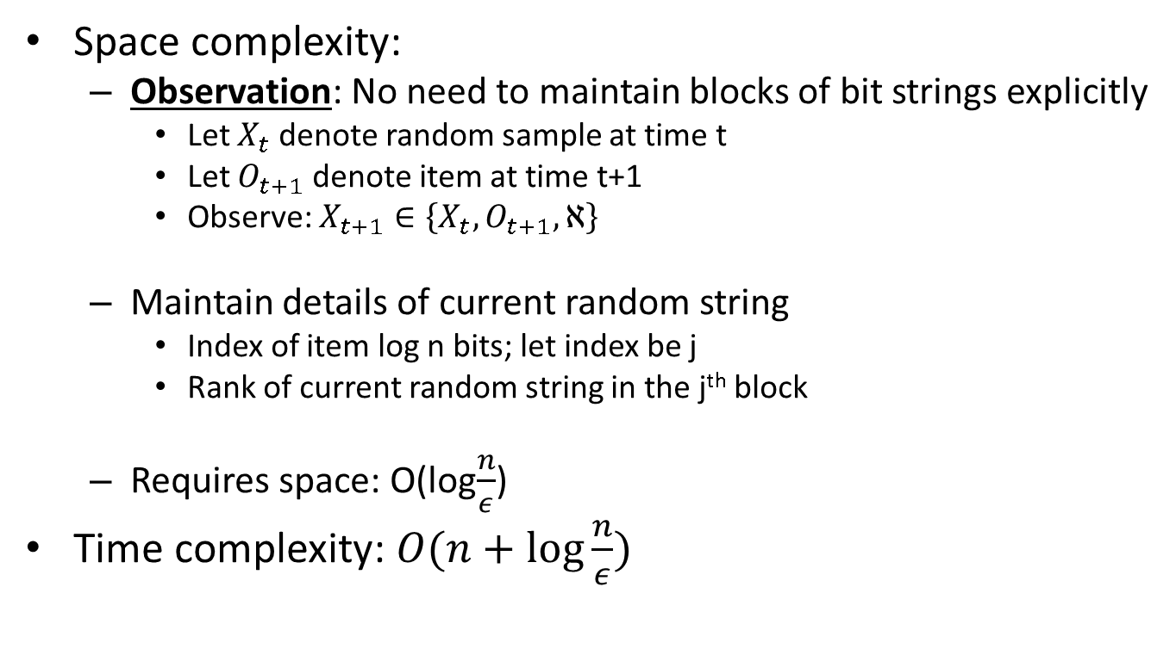
Analysis contd..
Space complexity:
  Observation: No need to maintain blocks of bit strings explicitly
    Let $X_{t}$ denote random sample at time t
    Let $O_{t+1}$denote item at time t+1
    Observe: $X_{t+1}∈\left\{X_{t}, O_{t+1}, ℵ\right\}$
  Maintain details of current random string
    Index of item log n bits; let index be j
    Rank of current random string in the j^{th} block
  Requires space: O(log$\frac{n}{ε}$)
Time complexity: $O(n+\log{\frac{n}{ε}) }$

Slide 28

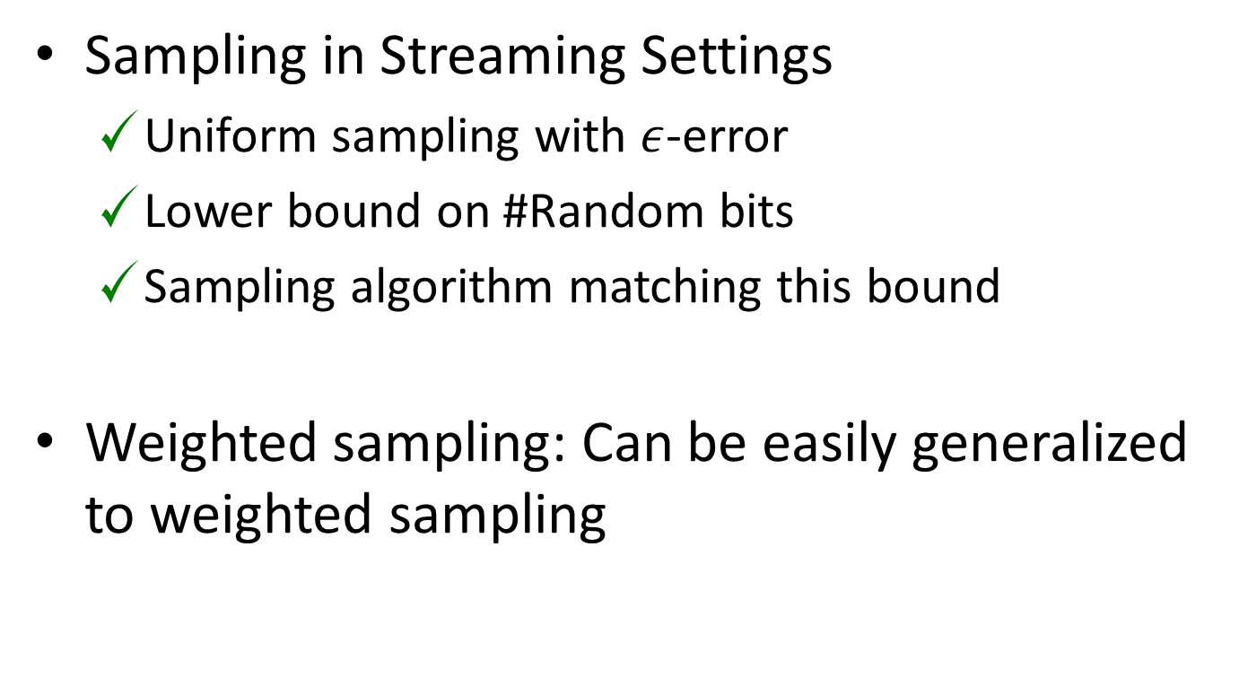
Summary of Sampling with $ε$-error
Sampling in Streaming Settings
  Uniform sampling with $ε$-error
  Lower bound on #Random bits
  Sampling algorithm matching this bound
Weighted sampling: Can be easily generalized to weighted sampling

Slide 29
Sampling in Query Model

Slide 30
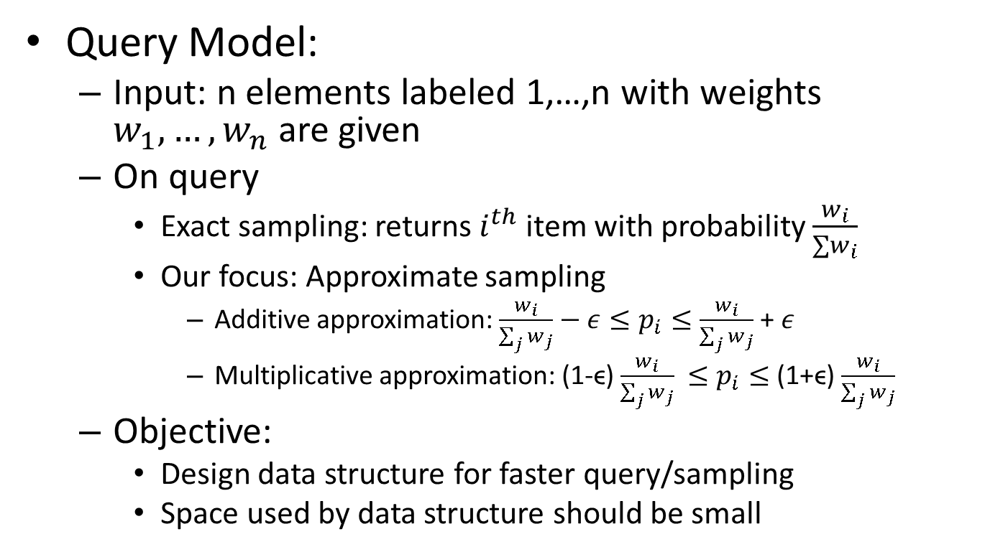
Space Restricted Setting: Query Model
Query Model:
  Input: n elements labeled 1,…,n with weights $w_{1},…,w_{n}$are given
  On query
    Exact sampling: returns $i^{th}$ item with probability $\frac{w_{i}}{∑w_{i}}$
    Our focus: Approximate sampling
      Additive approximation: $\frac{w_{i}}{\sum_{j}{w_{j}}}−ε≤p_{i}≤\frac{w_{i}}{\sum_{j}{w_{j}}}$+ $ε$
      Multiplicative approximation: (1-ϵ) $\frac{w_{i}}{\sum_{j}{w_{j}}}$ $≤p_{i}≤$ (1+ϵ) $\frac{w_{i}}{\sum_{j}{w_{j}}}$
  Objective:
    Design data structure for faster query/sampling
    Space used by data structure should be small

Slide 31
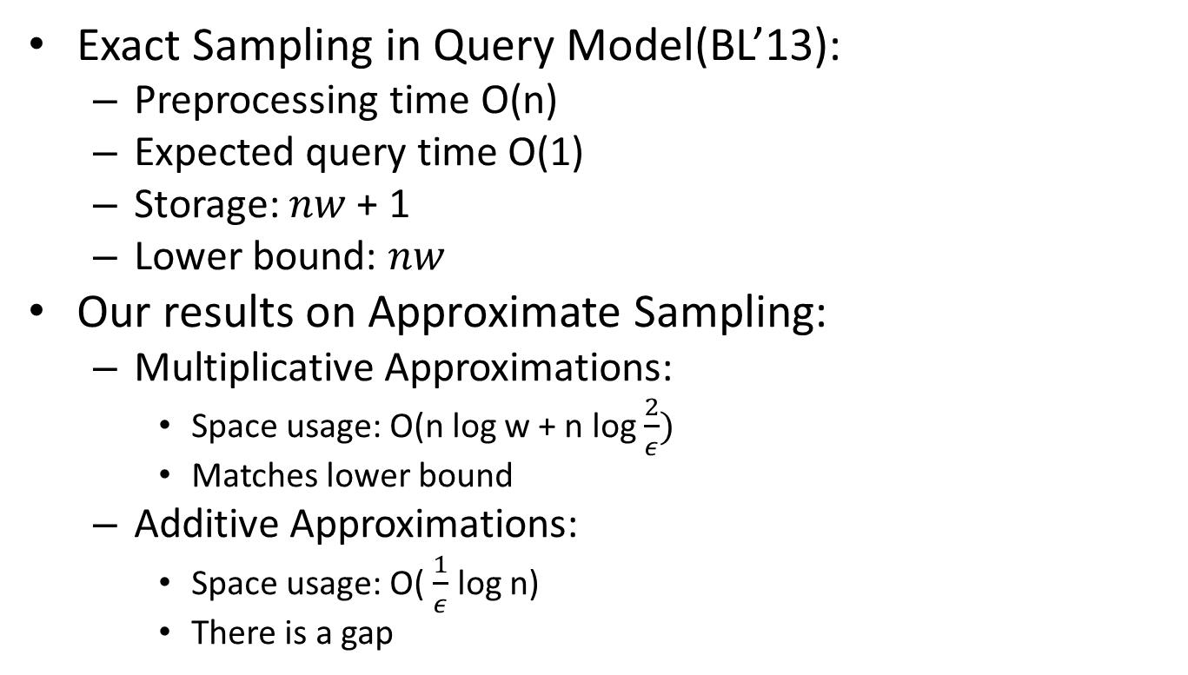
Sampling in Query Model
Exact Sampling in Query Model(BL’13):
  Preprocessing time O(n)
  Expected query time O(1)
  Storage: $nw$ + 1
  Lower bound: $nw$
Our results on Approximate Sampling:
  Multiplicative Approximations:
    Space usage: O(n log w + n log $\frac{2}{ε})$
    Matches lower bound
  Additive Approximations:
    Space usage: O( $\frac{1}{ε}$ log n)
    There is a gap

Slide 32
Thank You
Questions?

