Slide 1
Parallelism in Hardware-2

Slide 2
Recap
Cache memory
Virtual memory

Slide 3
Instruction-level parallelism
multiple functional units executing instructions simultaneously.
Pipelining arranges functional units are arranged in stages
Multiple issue initiates multiple instructions a the same time
float x[1000], y[1000], z[1000];
. . .
for (i = 0; i < 1000; i++)
z[i] = x[i] + y[i];
Pipelining: Fetch of X[1] and Y[1] and computation of x[0] +y[0] may happen in parallel by different pipeline units.
Multiple issue: Fetch of x[0], …, x[n] and y[0] … y[n] can be parallel

Slide 4
Fine Grained vs Coarse Grained Parallelism
ILP is a fine grained parallelism
Dependencies limit the scope of ILP.
f[0] = f[1] = 1;
for (i = 2; i <= n; i++)
f[i] = f[i-1] + f[i-2];
Coarse grain parallelism.
- execute larger/coarser unit of computation in parallel.
- Multithreading computation
t = a+b;
r = X[t];

Slide 5
Parallel Hardware
SIMD machine. Single Instruction Multiple Data
Single control unit and multiple ALU.
for (i = 0; i < n; i++)
x[i] = x[i]+y[i];

Slide 6
Vector processors
Vector registers
Vectorized and pipelined functional units.
Vector instructions
multiple “banks” of memory
Strided memory access: memory access separated by fixed intervals
Many x86 processor support vector computation
Compilers generate vector instructions
vr1 = b[0:3];
vr2 = c[0:3];
a[0:3] = vr1 + vr2;
for (i = 0; i <3; i++)
a[i] = b[i] + c[i];

Slide 7
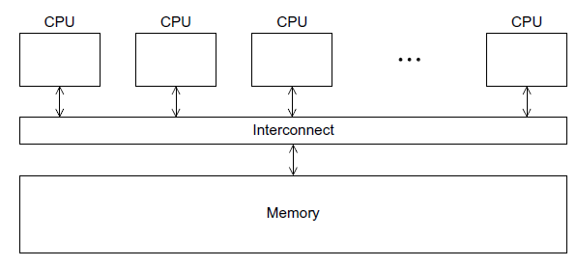
Shared Memory System
Processors communicate implicitly by accessing shared data residing on shared memory.

Slide 8
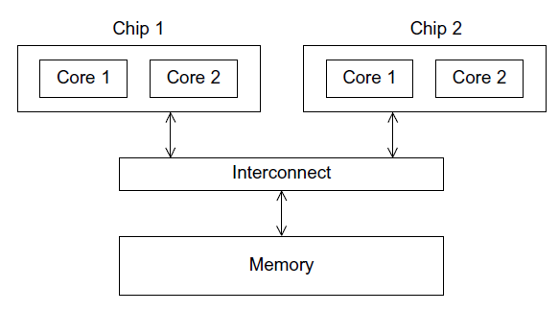
Uniform Memory Access System
processors are connected to main memory by interconnects
Shared memory access time is same for all processor

Slide 9
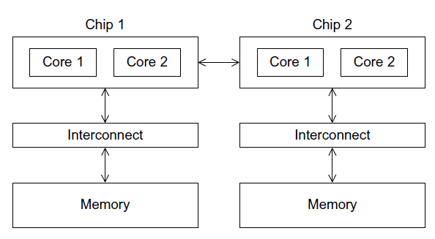
Uniform vs Non-Uniform Memory Access
each processor can have it’s block of main memory
processors access each others’ memory through special hardware
access to other processors’ memories may take longer

Slide 10
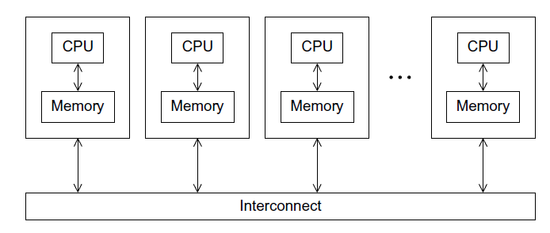
Distributed Memory System
each processor has its own private memory
the processor-memory pairs communicate over an interconnection network
Communicate by sending messages

Slide 11
Latency and Bandwidth
Latency is the time that elapses between the source’s beginning to transmit the data and the destination’s starting to receive the first byte.
Bandwidth is the rate at which the destination receives data after it has started to receive the first byte.
Let
l seconds be the latency of an interconnect and
b bytes per second be the bandwidth
Time taken to transmit a message of n bytes is l + (n/b)

Slide 12
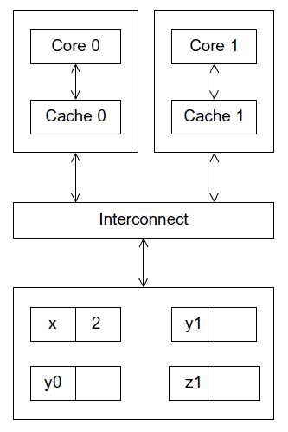
Cache Coherence
What are the possible values of y1 and z1?
y1 = 3*2 ➔ z1 = 4*2 = 8 or z1 = 4*7 = 28
y1 = 7*3 ➔
z1 = 7*3 = 21 and
z1 = 4*2 = 8 is not possible

Slide 13
Cache Coherence
x=2
What are the possible values of y1 and z1?
y1 = 3*2 ➔ z1 = 4*2 = 8 or z1 = 4*7 = 28
y1 = 7*3 ➔
z1 = 7*3 = 21 and
z1 = 4*2 = 8 is not possible

Slide 14
Cache Coherence Problem
X=1;
X=2;
r=X;
shared main memory

Slide 15
Snooping Based Cache Coherence Protocol
When the cores share a bus, any signal transmitted on the bus can
be observed by all the cores connected to the bus
core 0 updates the copy of x stored in its cache,
Core 0 broadcasts this information(cache line that contains x is updated) across the bus
core 1 is snooping the bus,
Sees that x (or the cache line that contains x) has been updated
It can mark its copy of x as invalid.
snooping works with both write-through and write-back caches

Slide 16
Drawback of Snooping Based Protocol
Broadcasts are expensive
Snooping protocol broadcasts every time a variable is updated
Not scalable, in larger systems due to performance

Slide 17
Directory-based cache coherence Protocol
The distributed directory stores the status of each cache line.
Each core/memory pair stores the status of the cache lines in its local memory.
A read operation updates the directory entry corresponding to that line with the information about the core
When a variable is updated, the directory is consulted, and the cache controllers of the cores that have that variable’s cache line in their caches are invalidated.
Pros. only the cores storing that variable need to be contacted.
X=Y; || Y=Z; || Z=X; // T1{X,Y}, T2{Y,Z}, T3{Z,X}
Cons. Substantial additional storage required for the directory

Slide 18
False Sharing
CPU caches operate on cache lines, not individual variables
Update on one variable ➔
mark the cache line as dirty, other cores fetch the data from the main memory
int i, j, iter_count;
/* Shared variables initialized by one core */
int m, n, core_count; double y[m];
iter_count = m/core_count;
/* Core 0 */
for (i = 0; i < iter_count; i++)
for (j = 0; j < n; j++)
y[i] += f(i,j);
/* Core 1 */
for (i = iter_count+1; i < 2*iter_count; i++)
for (j = 0; j < n; j++)
y[i] += f(i,j);
int i, j, m, n;
double y[m];
/* Assign y = 0 */
. . .
for (i = 0; i < m; i++)
for (j = 0; j < n; j++)
y[i] += f(i,j);
core_count=2
m=8
doubles are 8 bytes
cache line 64 bytes

Slide 19
References
Chapter 2
An Introduction to Parallel Programming
by Peter Pacheco.

