Slide 1
Cloud Platforms - I
Amazon Infrastructure as a Service
Cloud Economics - Infrastructure

Slide 2
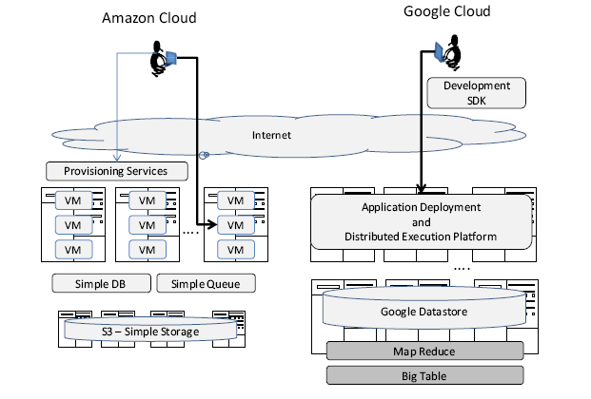
IAAS vs PAAS

Slide 3
Essential features of a `Cloud’ service
“pay-per-use”
rapid end-user provisioning
commoditized service

Slide 4
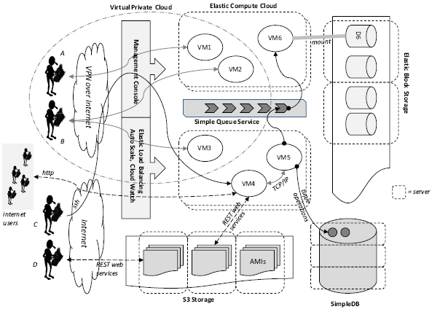
Amazon IAAS

Slide 5
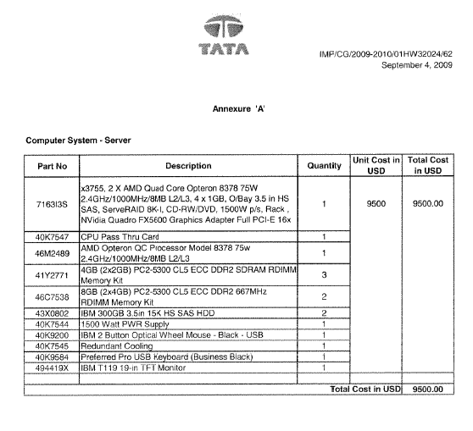
Cloud Economics

Slide 6
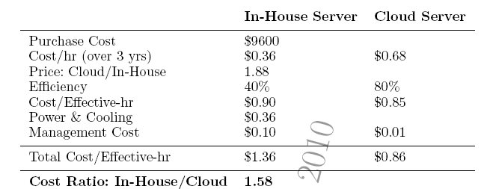
Cloud Economics (cont.)

Slide 7
Cloud Economics in more Detail
Can we use `private’ clouds equally well??
Consumer: can avoid provisioning for peak load
Provider: can amortize load across a larger variability of usage profiles
Cloud platforms offer computing infrastructure at significantly cheaper TCO - let’s see how true this is and when??

Slide 8
Public vs Private Cloud
Area under `provisioned capacity’ curve for public cloud
where D_T is the area under the demand curve D(t)
For a private cloud, T D_max needs to be provisioned

Slide 9
Public vs Private Cloud (cont)
If price of a computing hr = c;
and cost of power p – in a private cloud
Using cost of public cloud computing hr= 2 c
We get (assuming c=p, which is the experience in practice)
So, with D_max = D_min, it makes no difference!
In practice, this is difficult, and often this ratio is > 5, so public cloud wins

