Slide 1
Quantization

Slide 2
Content
Motivation from tensorflow doc
Overview of quantization methods from survey paper
Two methods in more depth
One based on two tools
The other based on a research paper

Slide 3
From https://www.tensorflow.org/performance/quantization

Slide 4
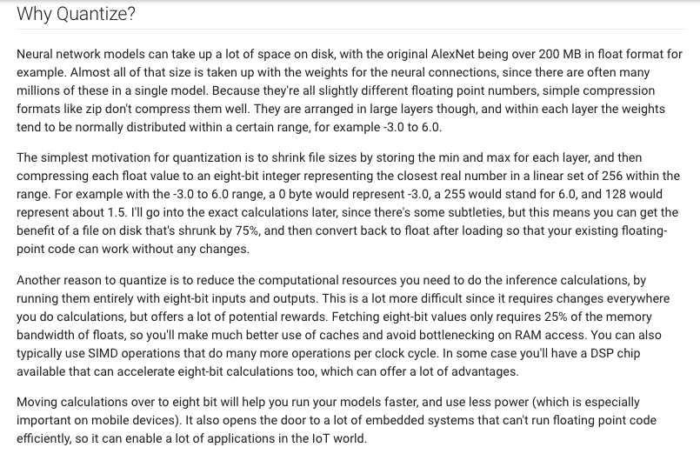
From https://www.tensorflow.org/performance/quantization
storage
latency
energy

Slide 5
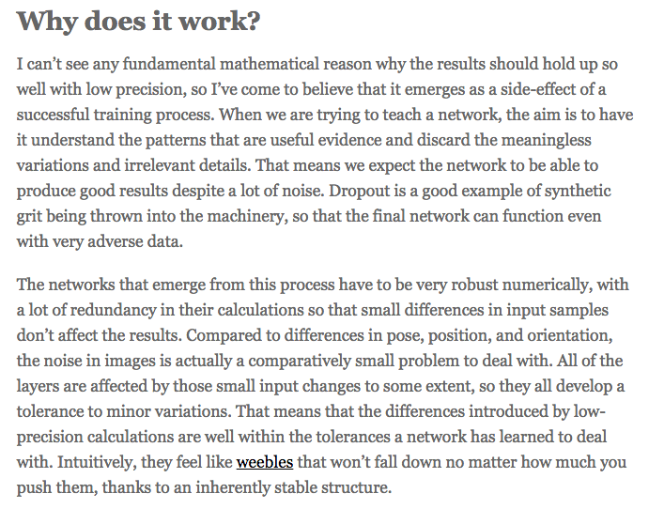
https://petewarden.com/2015/05/23/why-are-eight-bits-enough-for-deep-neural-networks/
accuracy

Slide 6
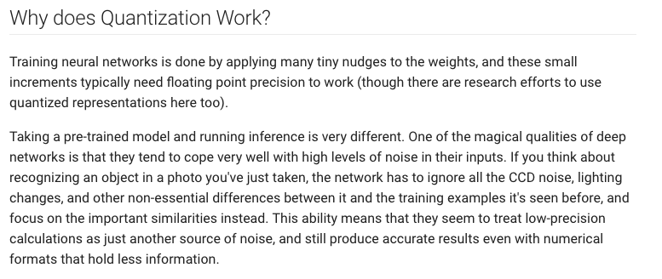
accuracy
From https://www.tensorflow.org/performance/quantization

Slide 7
How to declare fixed point variables in code? How to do fixed point math in code?
https://github.com/eteran/cpp-utilities
Wrapper class with integer arithmetic.

Slide 8
Quantization results comparison
Network: Alexnet Dataset: Imagenet Accuracy measured: Top-5 error
From V. Sze, T.-J. Yang, Y.-H. Chen, J. Emer, "Efficient Processing of Deep Neural Networks: A Tutorial and Survey," arXiv, 2017.

Slide 9
Quantization results: only weights
Network: Alexnet Dataset: Imagenet Accuracy measured: Top-5 error
From V. Sze, T.-J. Yang, Y.-H. Chen, J. Emer, "Efficient Processing of Deep Neural Networks: A Tutorial and Survey," arXiv, 2017.

Slide 10
Quantization results: both weights and activations
Network: Alexnet Dataset: Imagenet Accuracy measured: Top-5 error
From V. Sze, T.-J. Yang, Y.-H. Chen, J. Emer, "Efficient Processing of Deep Neural Networks: A Tutorial and Survey," arXiv, 2017.

Slide 11
Quantization results: binary values
https://github.com/MatthieuCourbariaux/BinaryConnect
https://github.com/allenai/XNOR-Net
Network: Alexnet Dataset: Imagenet Accuracy measured: Top-5 error
From V. Sze, T.-J. Yang, Y.-H. Chen, J. Emer, "Efficient Processing of Deep Neural Networks: A Tutorial and Survey," arXiv, 2017.

Slide 12
Quantization results: more details
Network: Alexnet Dataset: Imagenet Accuracy measured: Top-5 error
From V. Sze, T.-J. Yang, Y.-H. Chen, J. Emer, "Efficient Processing of Deep Neural Networks: A Tutorial and Survey," arXiv, 2017.

Slide 13
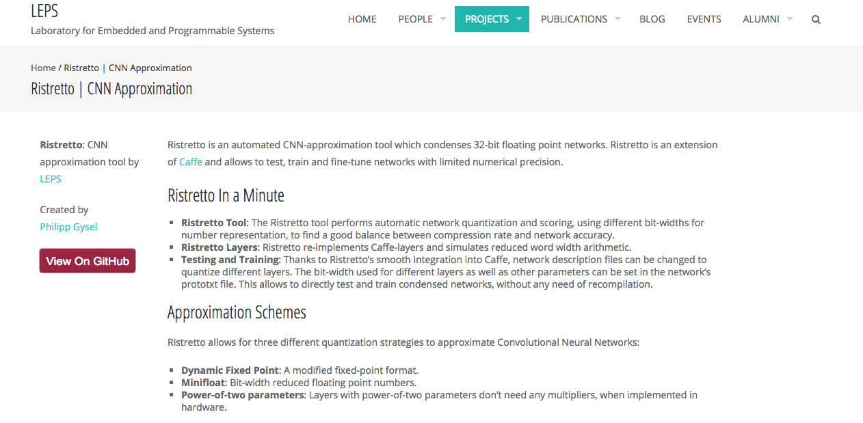
Dynamic fixed point

Slide 14
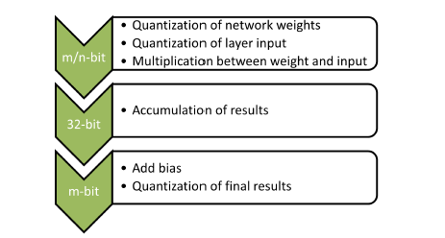
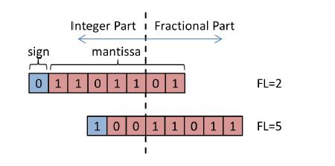
Ristretto quantization methods: fixed point, dynamic fixed point, minifloat
Deterministic rounding
Stochastic rounding
Dynamic fixed point

Slide 15
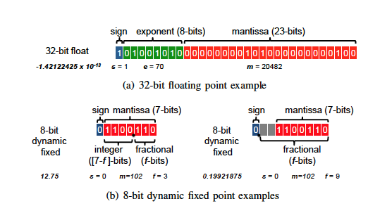
Dynamic Fixed Point, where to put the point?
Range vs. precision
IEEE 754 standard floating point
Dynamic Fixed point

Slide 16
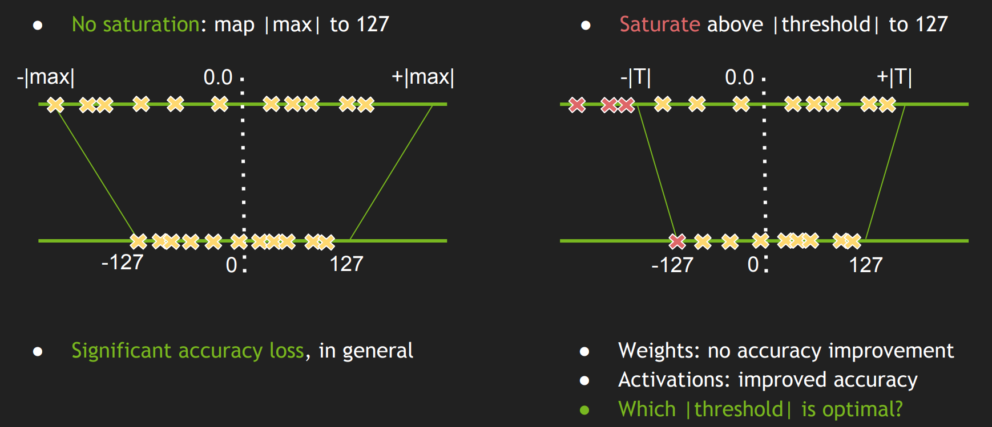
TensorRT: where to saturate?
Symmetric linear quantization

Slide 17
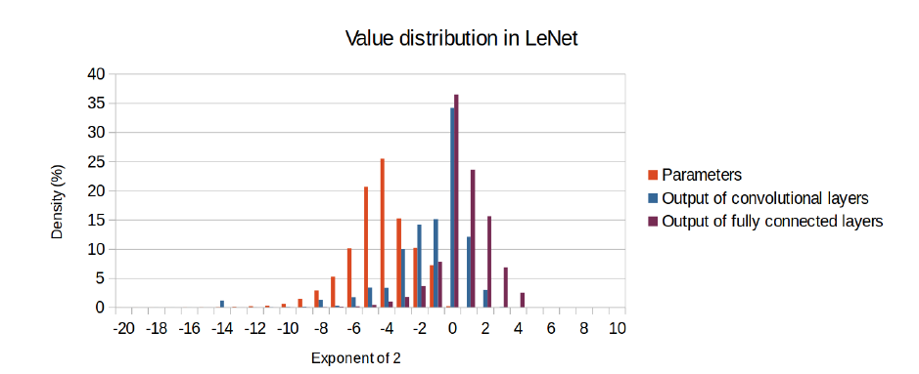
Empirical observations: Dynamic range of parameters and activations in LENET

Slide 18
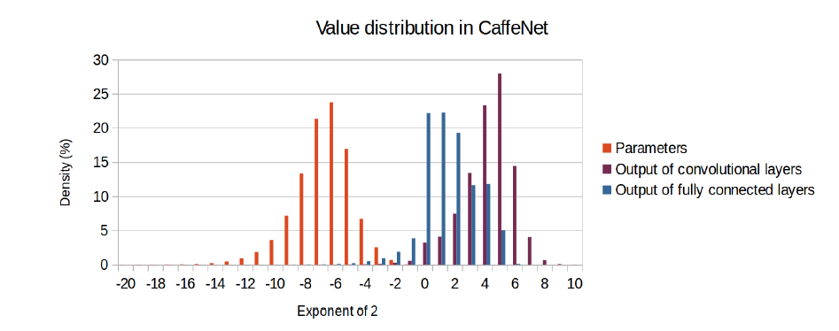
Empirical observations: Dynamic range of weights and parameters in CaffeNet

Slide 19
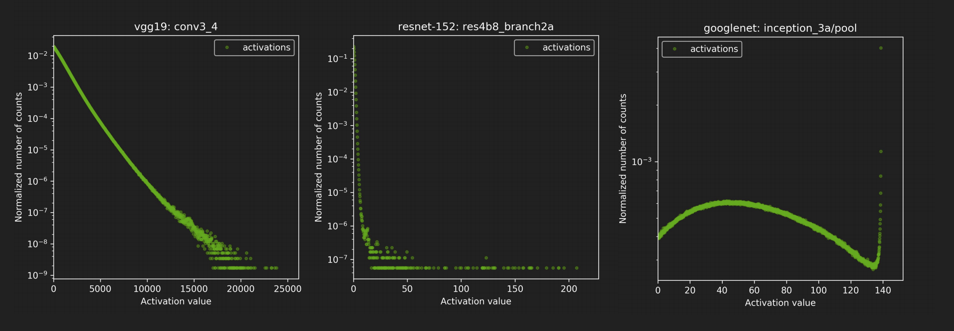
TensorRT: empirical observations

Slide 20
Empirical Observations
Different networks have different range of weights and activations
Weights and activations within same network have different numerical ranges

Slide 21
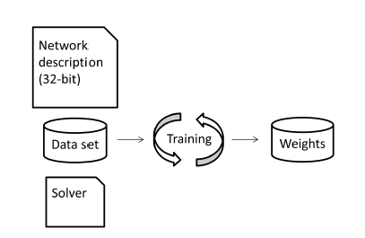
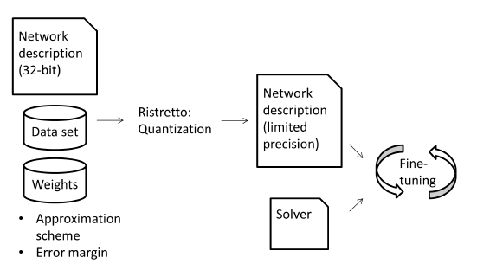
Ristretto: a quantization tool built on Caffe

Slide 22
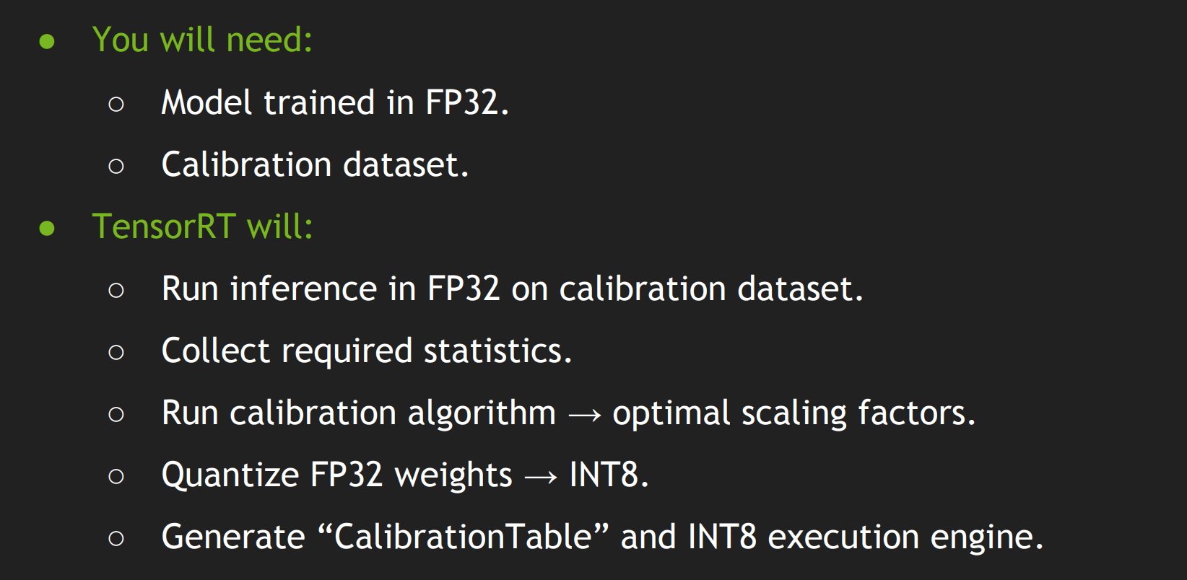
For TensorRT

Slide 23
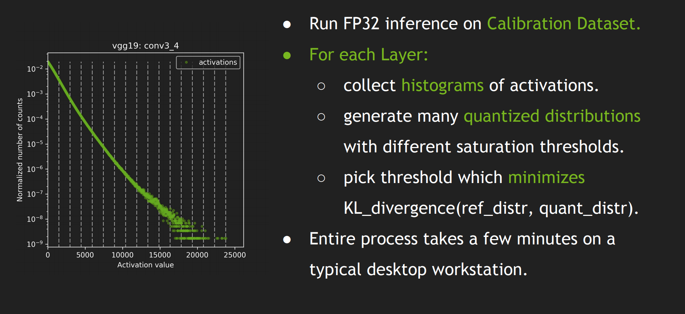
For TensorRT

Slide 24
Different networks need different bit-widths and formats, depends on quantization method

Slide 25
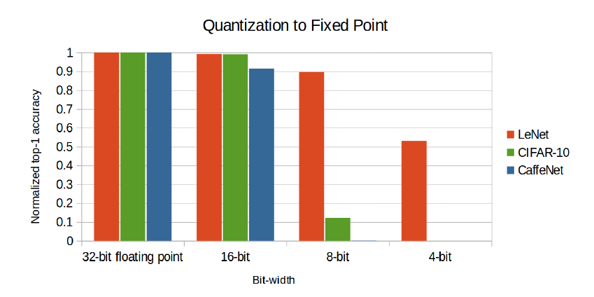
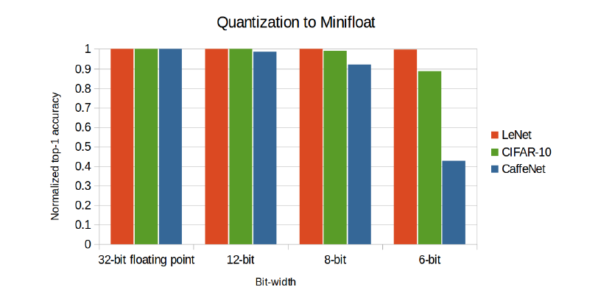
Different networks need different bit-widths (depends on quantization method)

Slide 26
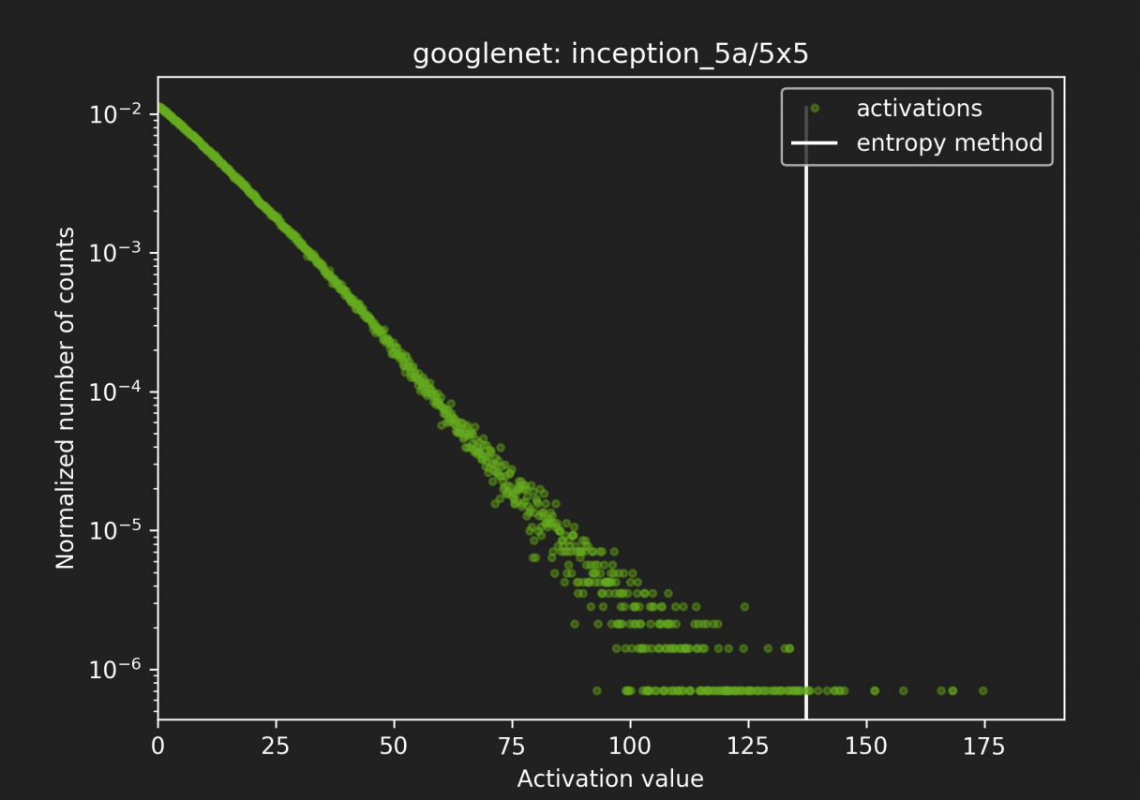
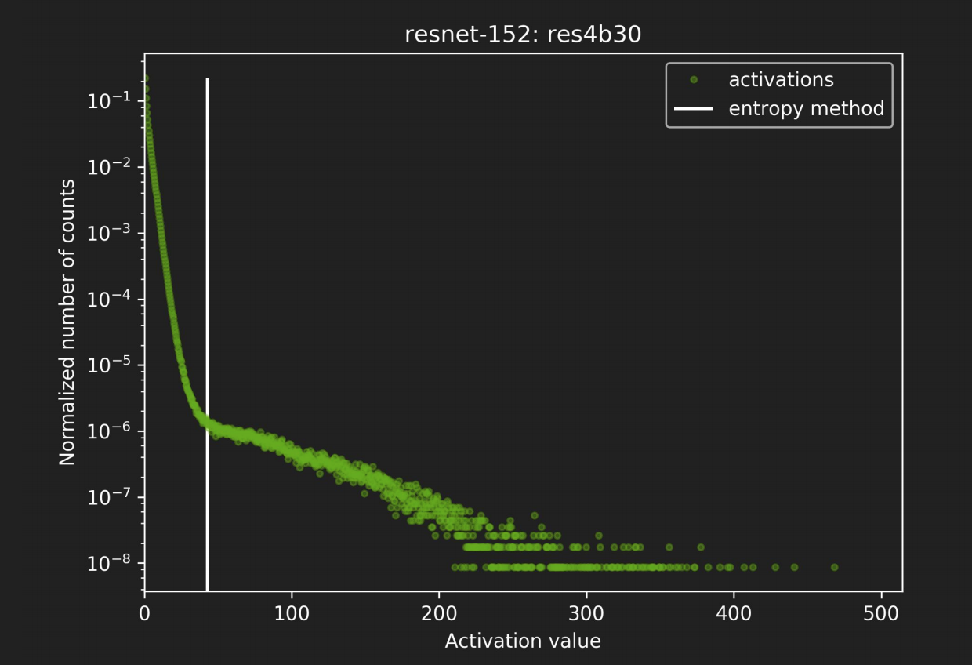
TensorRT: network specific thresholds

Slide 27
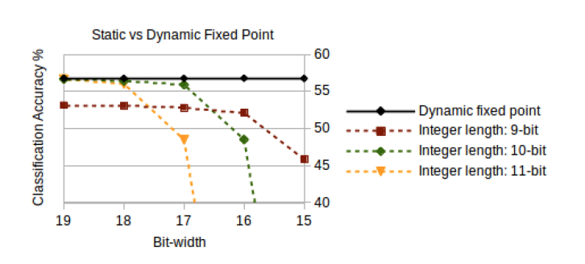
Dynamic fixed point better than static fixed point -> exploits different layers within the network having different numerical ranges

Slide 28
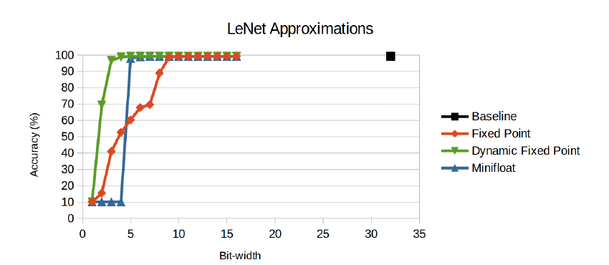
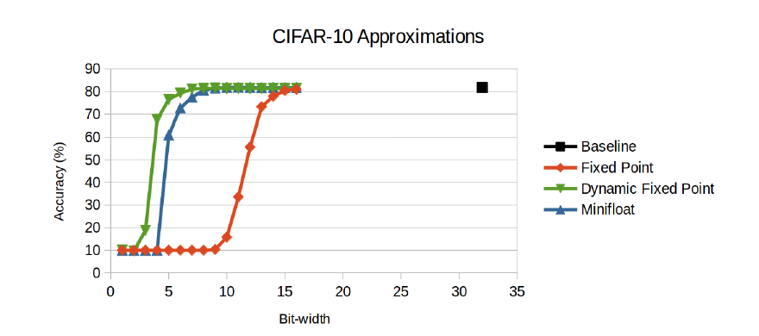
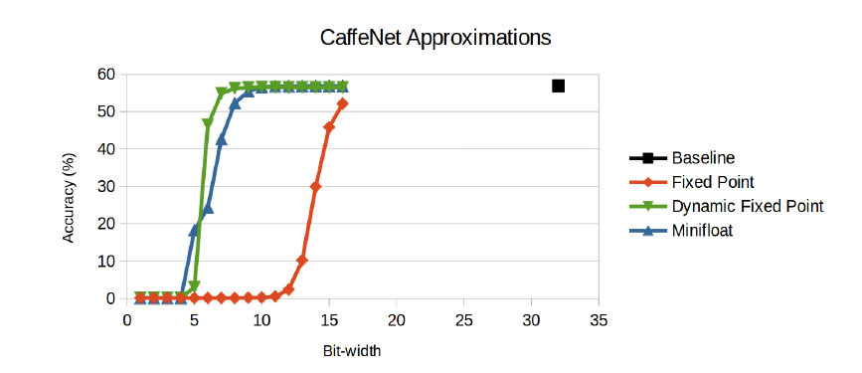
Dynamic fixed point performs best

Slide 29
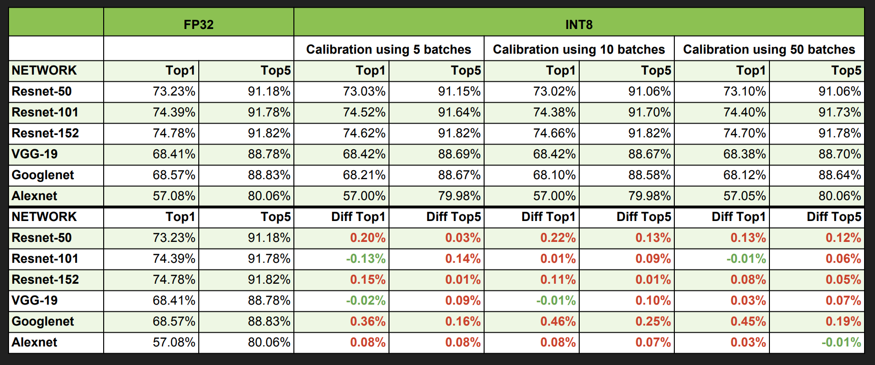
TensorRT accuracy

Slide 30
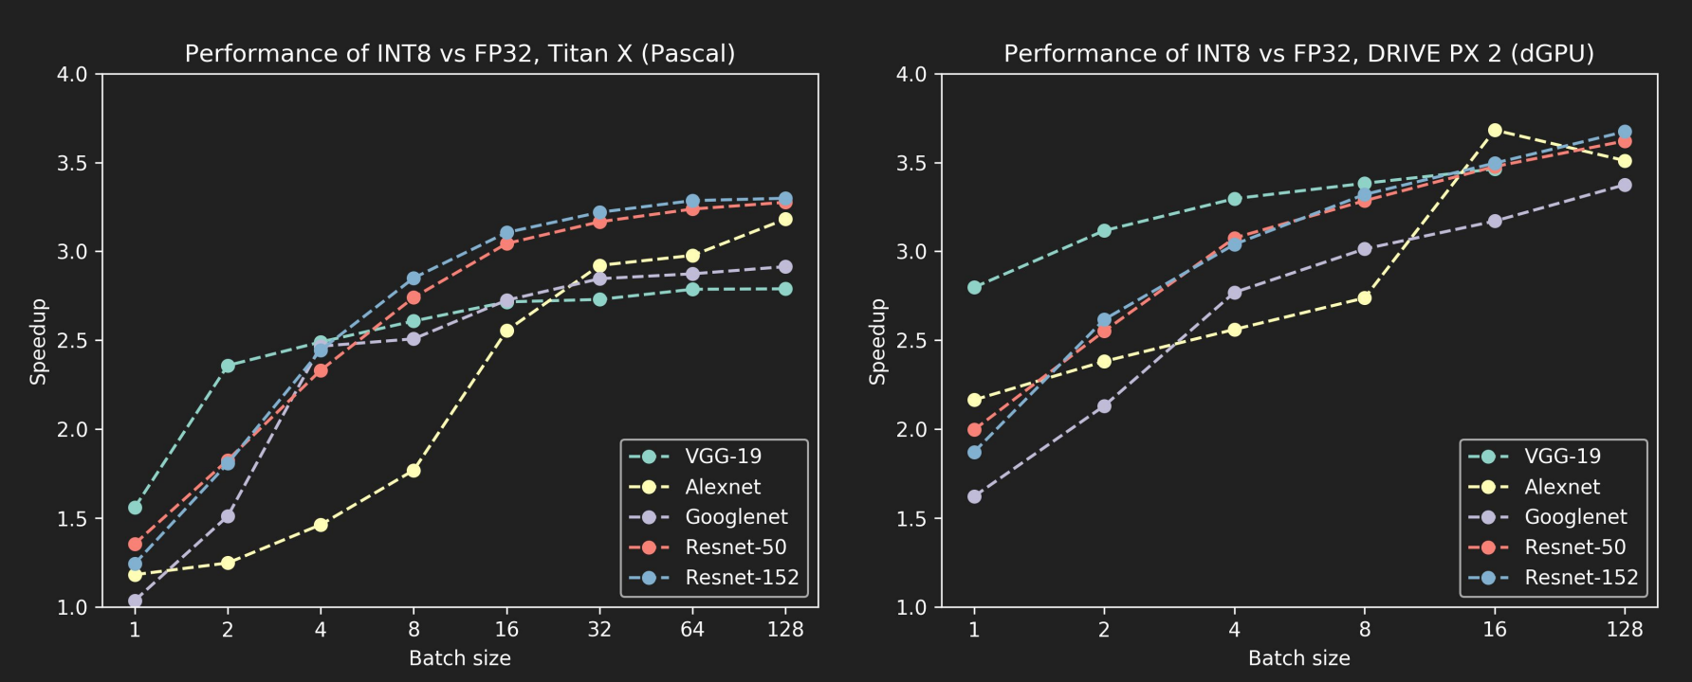
TensorRT performance

Slide 31
Deep Compression: Compressing Deep Neural Networks with Pruning, Trained Quantization and Huffman Coding Song Han, Huizi Mao, William J. Dally ICLR 2016

Slide 32
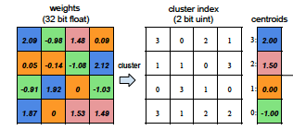
K-means clustering based quantization
Bit-width representation of each weight doesn’t change, so each weight is still the same size
Each weight represented by the mean value of the cluster it belongs to
Number of unique weights change, storage requirements reduce due to this weight sharing
Minimizes within cluster
sum of squares

Slide 33
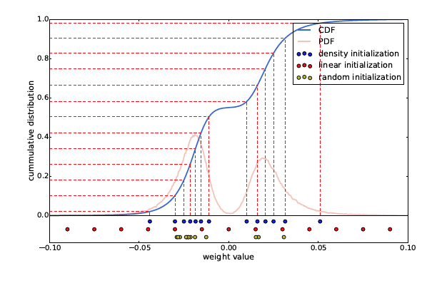
Cluster initialization

Slide 34
Linear Initialization gives best results
Larger weights play a more important role than smaller weights (Han et al., 2015), but there are fewer of these large weights. Thus for both random initialization and density-based initialization, very few centroids have large absolute value which results in poor representation of these few large weights. Linear initialization does not suffer from this.

Slide 35
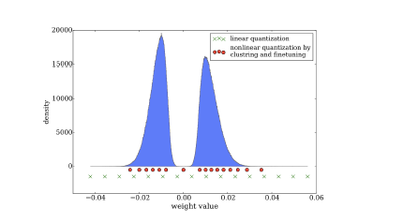
Quantization after pruning
Unsupervised K-Means clustering of weights benefits from pruning.
Pruning retains more important weights, that can be grouped into more meaningful clusters.

Slide 36
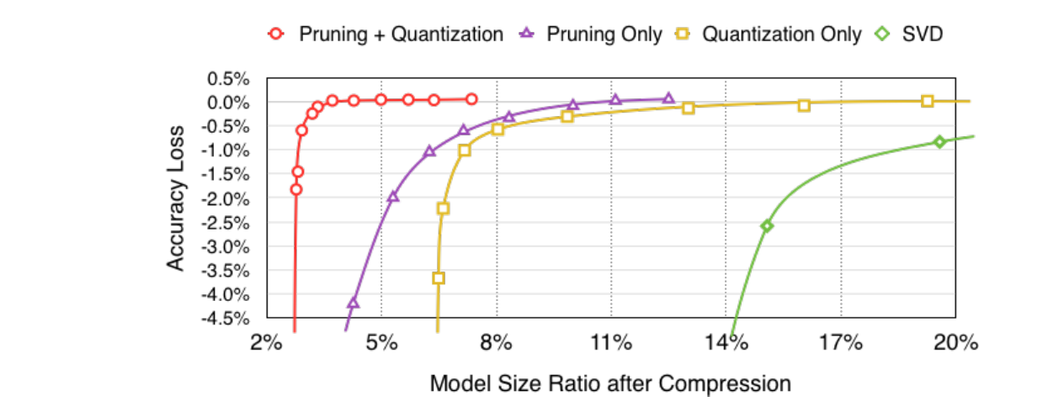
Benefits of pruning

Slide 37
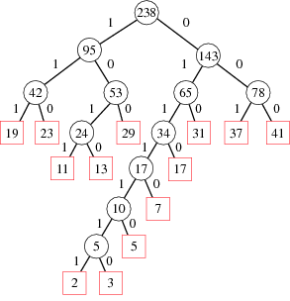
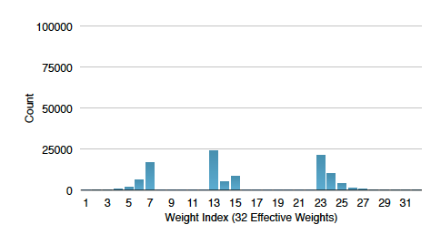
Huffman encoding
Opportunity for Huffman Encoding, as seen from
the empirical values of weights

Slide 38
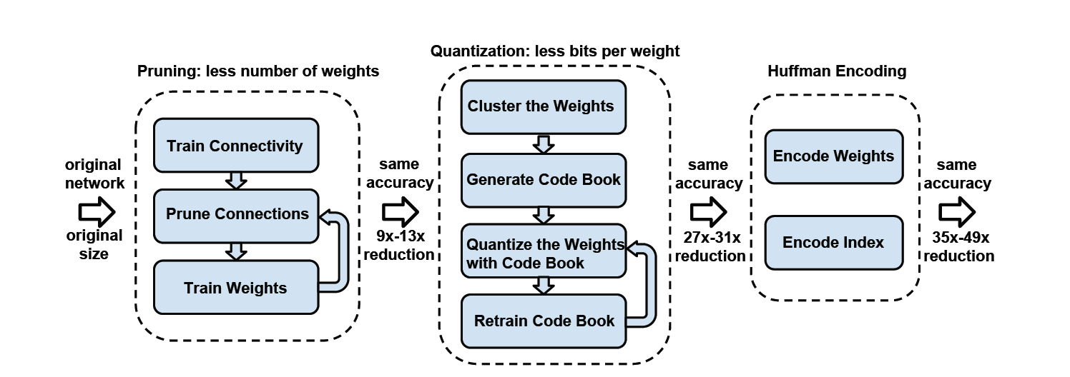
Overall flow

Slide 39
FC layer performance improvements

Slide 40
Accuracy and data storage -> network weights and activations/ quantization bit widths. Latency/energy -> hardware platform (CPU with SIMD vs. GPU vs. FPGA? has floating point co-processor unit? 8-bit vs. 16 bit vs. 32 bit addressing ……)

Slide 41
Floating vs. fixed point performance, hardware dependency
(1) http://www.ti.com/lit/wp/spry061/spry061.pdf
(2) https://www.eetimes.com/document.asp?doc_id=1275364
(3) https://stackoverflow.com/questions/25351114/is-fixed-point-math-faster-than-floating-point-on-armv7-a
(4) https://community.arm.com/processors/f/discussions/1466/neon-fixed-point-coding-and-fixed-vs-floating-point-operations-performance-comparison
(5) challenges of fixed point: http://www.artist-embedded.org/docs/Events/2009/EmbeddedControl/SLIDES/FixPoint.pdf slide 20
(6) https://blogs.mentor.com/colinwalls/blog/2012/09/10/the-floating-point-argument/
(7) https://dsp.stackexchange.com/questions/4835/relative-merits-of-fixed-point-vs-floating-point-computation

Slide 42
Next ….
Riju to-do: update page with slides/ other content
Fri one-to-one class Pranshu, Daniel
Tue: finish factorization with CP/Tucker decomposition for tensors, sum up decomposition, pruning, quantization i.e. all post training network optimization methods

