Slide 1
Mobility Assistant for Visually Impaired (MAVI) ANDROID APP
Nipun Gupta
2011CS50289
(Minor Project)

Slide 2
ACKNOWLEDGEMENT
I would like to express my deepest and sincere gratitude to Prof. M.Balakrishnan and Dr. Chetan Arora for their valuable suggestions, discussions and continuous support throughout the course of the project.
I would also like to thank each student in MAVI group for his/her constant support and active collaboration.

Slide 3
OUTLINE
Objective
Overall Design Workflow
App Design Workflow
Communication with Controller
Bluetooth connection
JSON format
Server side
Mobile app interface
Implementation problem faced
Proposed solution for future

Slide 4
OBJECTIVE
To help visually impaired navigate easily using MAVI app
Audio navigation
Self-sufficient
Signboard detection
Texture detection
Face detection & recognition
Safety
Pothole detection
Animal Detection (cows & dogs)

Slide 5
OVERALL DESIGN WORKFLOW
Respective Outputs
CAMERA
GPS/IMU UNIT
CONTROLLER
Input Image Stream (RGB+Depth)
SIGNBOARD DETECTION
CONTROLLER
MOBILE APP
FACE DETECTION & RECOGNITION
Required input images (RGB, Gray, Depth) at respective frame rates (FPS)
TEXTURE (POTHOLE) DETECTION
SERVER & DATABASE

Slide 6
MOBILE APP DESIGN WORKFLOW
SERVER & DATABASE
CONTROLLER
Http Request -
Post, Get, Put, Delete
Bluetooth Connection
Outputs of all modules in JSON format
SignBoard
Texture
Face
Position
APIs made available to access database (MongoDB)
Create (C)
Read (R)
Update (U)
Delete (D)
MOBILE APP

Slide 7
INFO FROM CONTROLLER
Sign Board Detection
True/False (detected or not)
If yes, then retrieve info according to position
Texture (Pothole) Detection
Road / pavement / grass / not detected
Pothole (true/false): if true, raise an alarm/vibrate
Face Detection & Recognition
Number of faces
Array of names (display them)
GPS Position
Latitude, longitude, altitude

Slide 8
JSON STRING FORMAT
Easily available APIs for conversion & parsing
Example:
{ positionString: { "pos_y": 77.1928700,
"pos_x": 28.5445833,
"pos_z": 215.6553276 },
signBoardString:{ "isSignBoardDetected": "True“ },
textureString:{ "texture": [[0, 0, 1], [0, 0, 1]],
"pothole": "True" }, faceDetectionString:{ "noOfFaces": "2“,
"nameArray": ["Name1", "Name2"] }
}

Slide 9
SERVER SIDE BLUETOOTH CONNECTION (APP)
UI THREAD
ACCEPT THREAD
CONNECTED THREAD
On button turns on device BT
Connect button runs Accept
Handler reads from queue
Creates server socket
Accepts a connection (UUID string)
Runs CT when socket is connected
Reads data from socket (1 msg / sec)
Passes the message into queue
SHARED MESSAGING QUEUE

Slide 10
SERVER AND DATABASE
SERVER
Java 1.8
Spring Framework
Class for each collection in DB. Example:
SignBoard
DATA BASE
MongoDB
Collection for each module. Ex – Signboard, FD
Other data
Latitude
Longitude
Bilingual
Content
User Profile
Maps metadata
JSON
String
Notes:
Face Detection Collection
Which faces any user is likely to meet

Slide 11
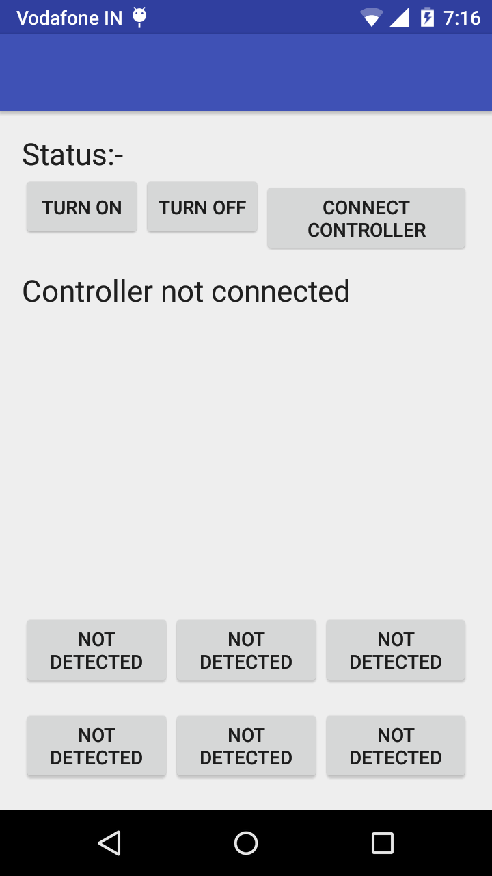
MOBILE APP INTERFACE
Default Screen
Displayed text converted to audio output
Texture detected on front, right and left (press button for audio)
Bluetooth control buttons

Slide 12
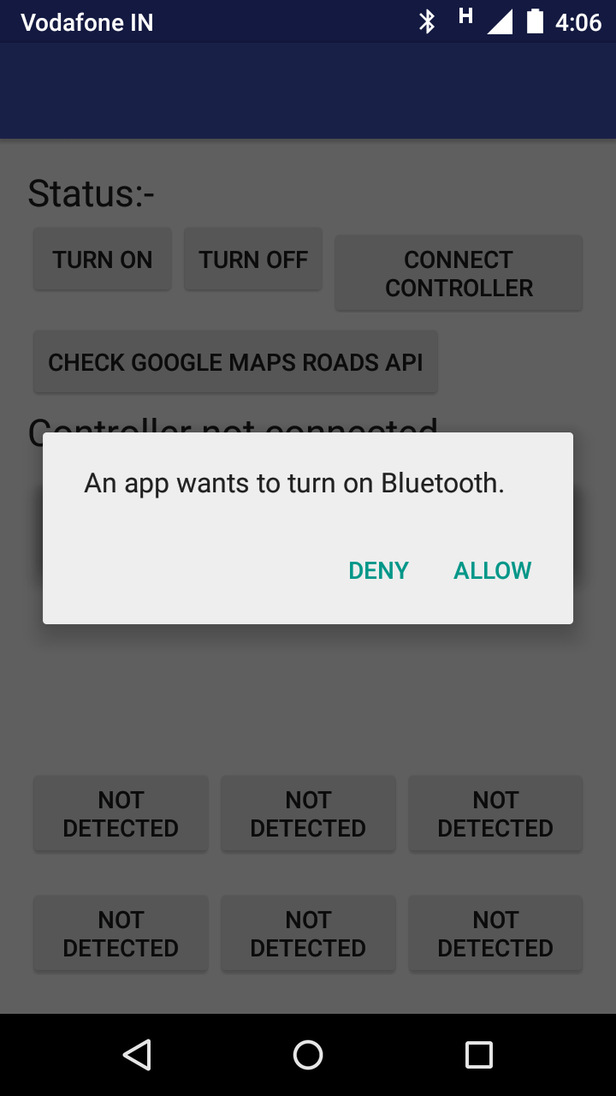
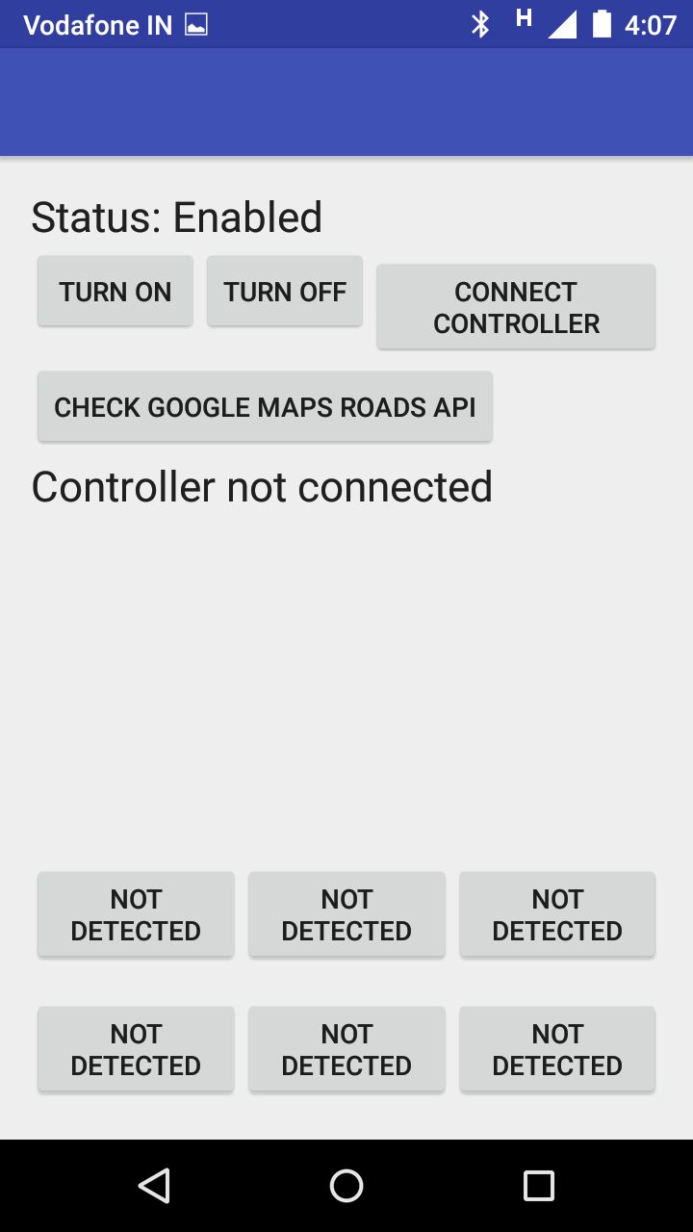
TURN ON DEVICE BLUETOOTH
Asks for permission
Status of BT
Connects to controller

Slide 13
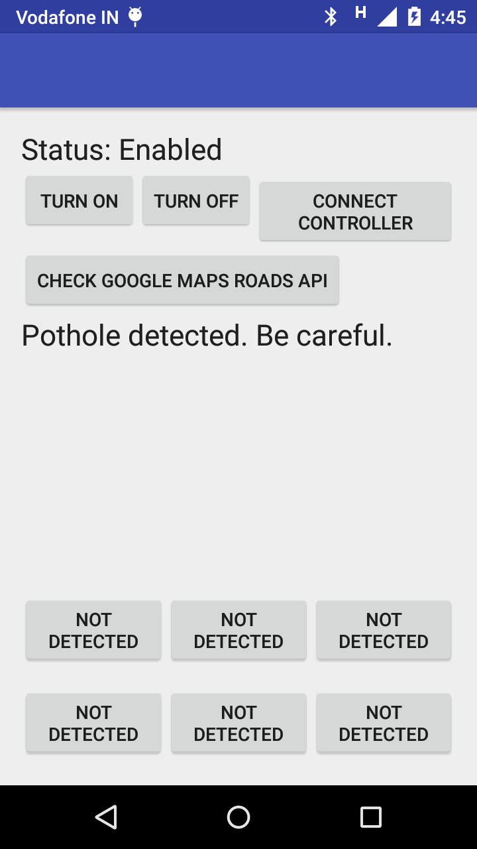
POTHOLE DETECTED
Pothole is detected by TD module
Vibration for 5 seconds to alert user
Highest priority
Displayed text converted to voice output

Slide 14
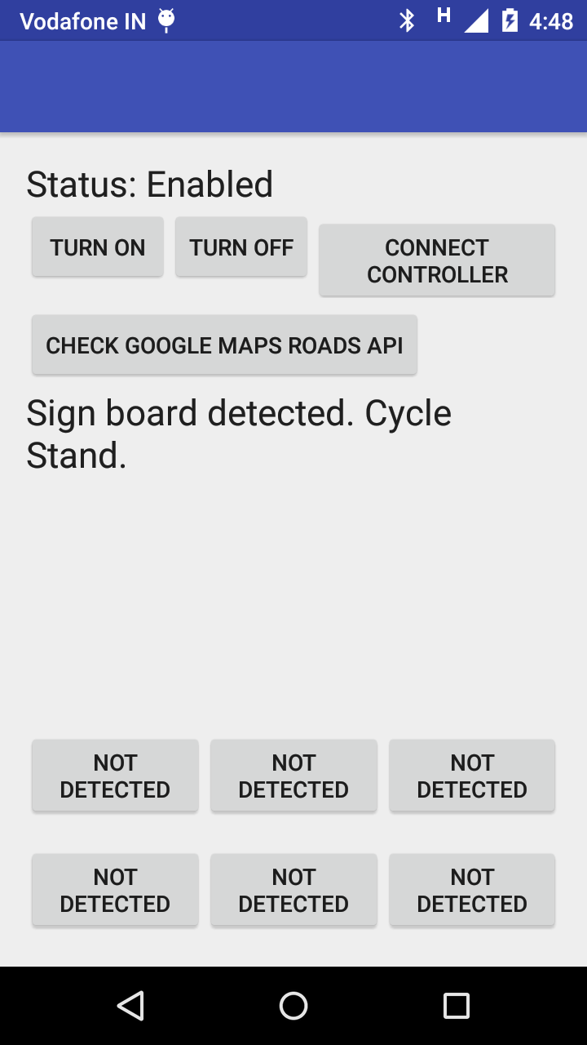
Signboard is detected by SD module
Retrieve content of signboard nearest to current position from server
Prioritized after pothole
Displayed text converted to voice output
SIGNBOARD DETECTED

Slide 15
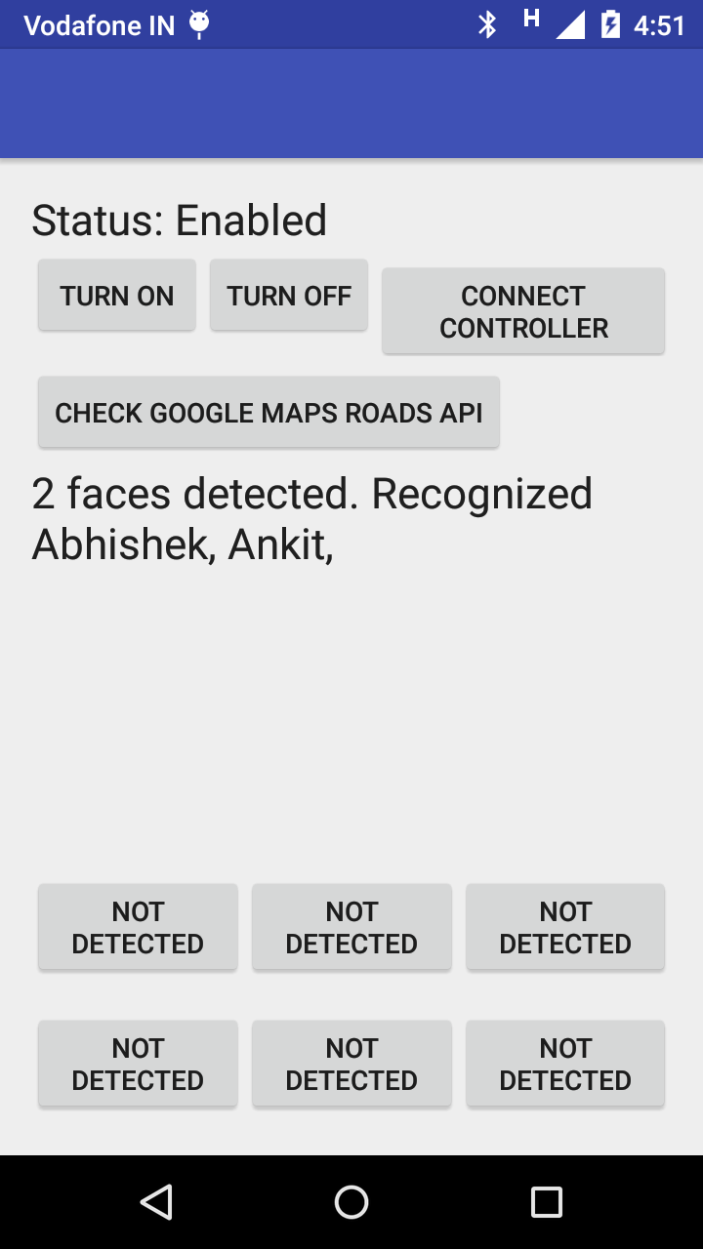
FACE DETECTED
Faces are detected by FD-FR module
Least priority
Displayed text converted to voice output

Slide 16
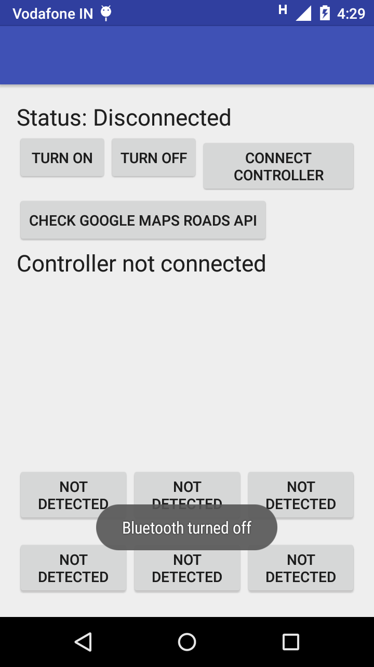
TURN OFF DEVICE BLUETOOTH
Status of BT

Slide 17
PROBLEM
Retrieve the contents of nearest signboard
Red signboard is shown
Yellow signboard is the correct one
Get nearest signboard in the direction of movement
(Final position – Initial position) vector gives direction
Direction can be inaccurate
Inaccuracies of GPS unit
User may not be walking directly towards signboard
Need to associate signboard and position to the road

Slide 18
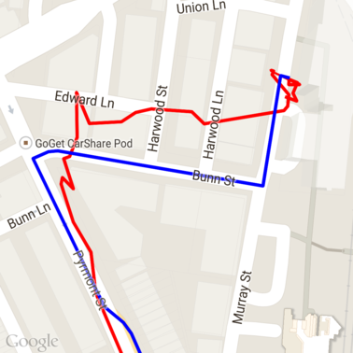
PROPOSED SOLUTION
Google Maps Roads API – SnapToRoads method
Input – path (list of latitude/longitude pairs)
Max 100 points in the path
Good quality if consecutive points within 300m
Output – list of snapped points (extra points)
placeID – unique identifier for a place
Corresponds to road segments
Tag each signboard with placeID
Google Places API or Google Maps Geocoding API
Get address of road (or roadname) using placeID
Other details also available

Slide 19
EXPERIMENT RESULTS
Small roads are not named (Example – SIT Building road)
Unnamed Road (with complete address)
Unique placeID for that road segment
Single road cross cuts multiple areas (Ex – Aurobindo Marg)
Road name is same, but address is different
Unique placeID for each segment
Other observations
Status NOT_FOUND for some placeID (not in database)
Tag signboards with placeID

Slide 20
FINDING NEXT SIGNBOARD
Input path (list of GPS coordinates)
Corresponding placeIDs (interpolate for more points)
Google Maps
Roads API
Find signboards tagged with required placeID
Nearest signboard in that direction
Find direction of movement (final – initial)
Subset of potential signboards

Slide 21
GITHUB
Handle: mavi-iitd
Organisation: IITD-MAVI
Server Repository
Backend code
Server and Databse
Mobile-App Repository
Android App

Slide 22
THANK YOU

